Slide 1
Wellbeing Workshop

Slide 2



What is wellbeing?

Slide 3

Our Shared Vision
Our vision is to work together so that everyone at Victoria Primary will be happy, caring, confident individuals who have a love of learning and achieve personal success.

Slide 4
Estyn inspection report
Wellbeing: Excellent
All pupils achieve high levels of wellbeing. Many pupils display excellent independent learning skills in lessons. They access
and use a wide range of learning resources efficiently iwithout teacher direction. In
the Foundation Phase, many pupils develop these skills to a high level through
regular use of the stimulating outdoor learning environment. In key stage 2, many
older pupils organise fair trade events independently, such as coffee mornings,
through contacts they initiate with local businesses.
Pupils are proud to be members of the school. Most are highly engaged and
motivated and are keen to learn. They enjoy school and work hard to the best of
their ability. All pupils feel safe in school. They have confidence that adults will
address successfully any issues that arise. Behaviour is good in lessons and around
the school, with most pupils showing care and kindness towards others. A good
feature of pupils’ development is their ability to share and to work co-operatively in
groups.
Most pupils have a secure understanding of how to lead a healthy lifestyle and many take a very active part in the extensive range of extra-curricular activities on offer to them.

Slide 5
Provision
2 week block at beginning of year focusing on
wellbeing and important life skills.
- Weekly PSE lessons (Apple/Zippy/Facts for life)
- ’Worry jars’, ‘Friendship group sessions’
Rainbow room- base for identified children at lunchtime.
Emotional Literacy Support sessions
Yoga/mindfulness
Family engagement officer- supports year 6 pupils
Weekly assemblies that promote positive health and wellbeing
‘5 a day’ sessions

Slide 6
Partnership for Children
- Used throughout the world to help children manage their emotions
www.partnershipforchildren.org.uk
6 modules
Feelings/Communication/Friendship
Conflict/Change and loss/Moving forward
Each module has 4 lessons( 45 mins )

Slide 7
A typical year 3/4 lesson
Loneliness and rejection
(Module 3 Rejection)

Slide 8
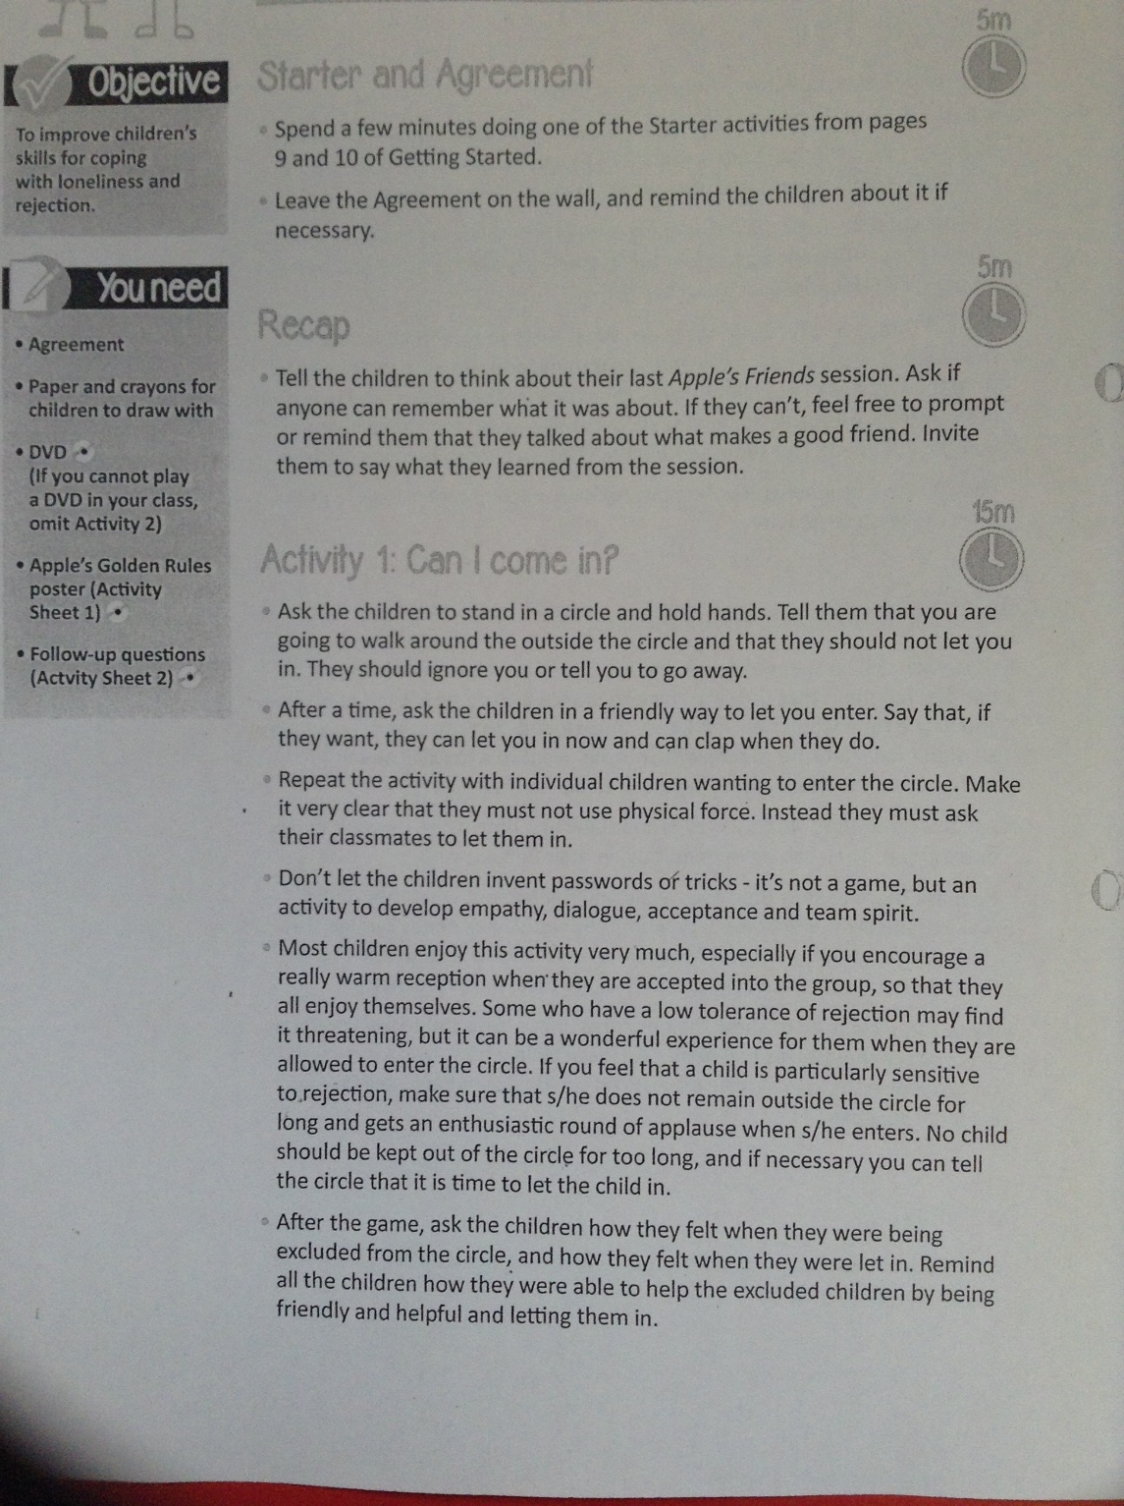

Slide 9
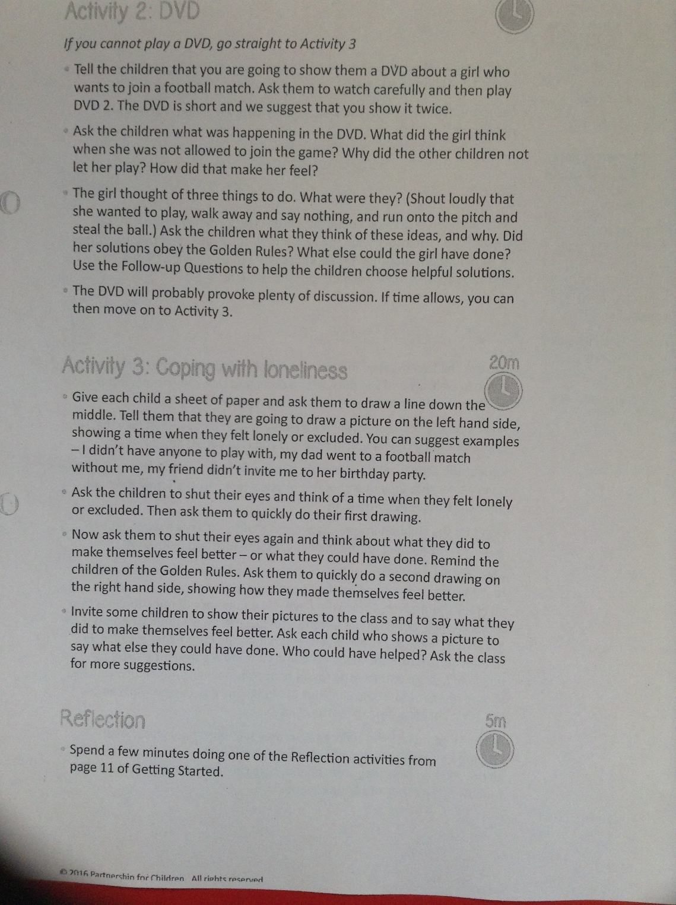

Slide 10
ELSA-Emotional Literacy Support Assistants
Support children identified from teacher
observation and analysis of data
Support covers a range of issues and can be delivered to individuals/small groups

Slide 11


Yoga sessions at Key Stage 1
Mindfulness at Key Stage 2

Slide 12

The Rainbow room
- A base for identified children to go to at lunchtime
-Calming and nurturing environment

Slide 13
Assessing wellbeing
-Every day and ongoing through LSA/teacher observation
-Children complete a ‘Selfie’ assessment twice a year ( Feb and June)
-Staff given time to analyse data with additional learning needs coordinator
-Ways forward planned

Slide 14

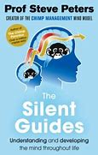
Well worth a read !

Slide 15

Signs and symptoms
Change in sleep patterns /bed wetting
Becoming withdrawn
Friendship groups: Can become less or more social than usual
Change in eating patterns
Notes:
Change in appearance: weight loss or gain, lack of self care, skin tone

Slide 16

Wellbeing – how can I support my child at home?
Creating opportunities for interactions with your children
Listening during both positive and negative times to your child- consistency of parent approach
Start a ‘good book’ to record the good things that happen during the day. Trains the brain to focus/notice the positive things in life
Good sleep routine
Monitoring social media access/screen time
Healthy diet/exercise

Slide 17
Useful Websites
https://https://parentzone.org.uk/advice/health-wellbeing
https://www.mentalhealth.org.uk/publications/make-it-count-guide-for-parents-and-carers
https://www.partnershipforchildren.org.uk/
https://youngminds.org.uk/resources/school-resources/parents-wellbeing/

