Slide 1

Understanding your child’s report
2023

Slide 2
Aim of the session:
To gain an understanding of ‘WHAT’ an end of year report looks like at Victoria Primary School.
To gain an understanding of ‘HOW’ to interpret the end of school year report at Victoria Primary School.

Slide 3
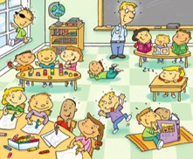
Assessment in the Curriculum for Wales
New Curriculum for Wales – September 2022
No longer have levels/ outcomes
Children are now working within Progression steps.
Notes:
The introduction of the Curriculum for Wales has seen a number of changes to the way we assess our children.

Slide 4
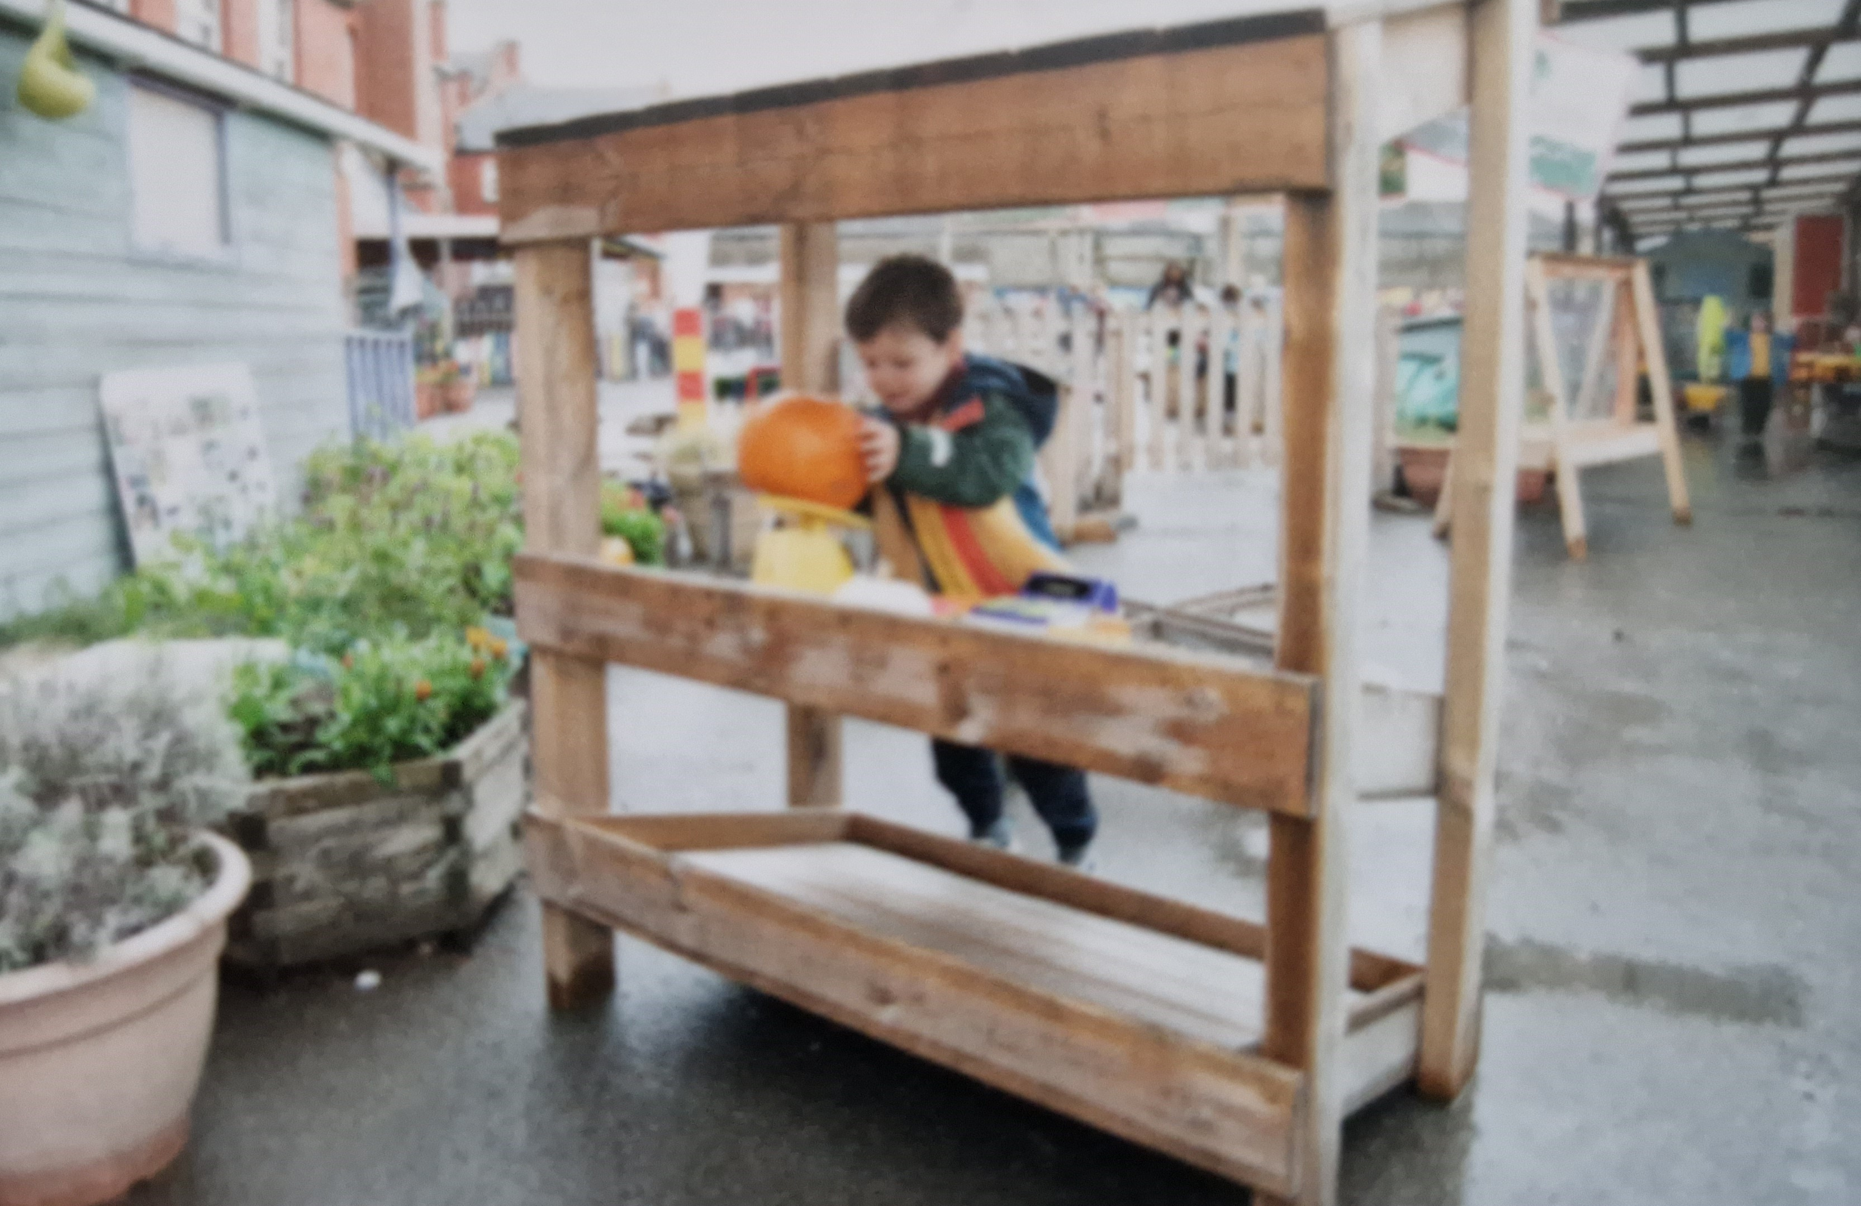
What does Assessment look like in VPS?
The majority of assessment is done informally, during lessons – immediate verbal feedback.
Formal assessment happens in the form of
Termly spelling tests Y1 – Y6
Termly reading tests Y1 – Y6
Twice yearly maths tests – Y1 – Y6
WG tests from Y2 – Y6 (reading, procedural, reasoning)
Notes:
We complete a number of summative, formal assessments throughout the year, but the majority of assessments happen, informally, whilst the children are learning and provide immediate feedback.

Slide 5
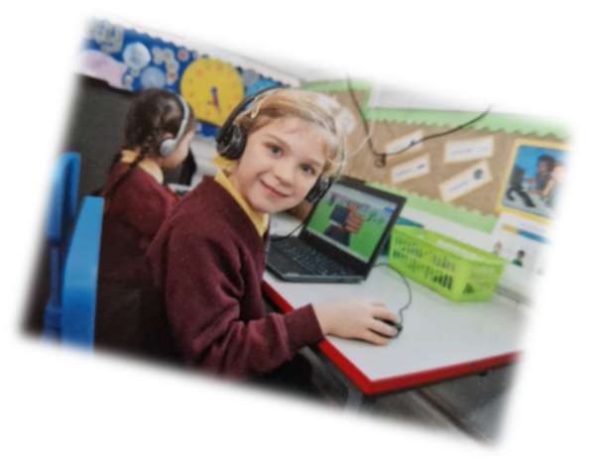


6 AREAS OF LEARNING
Notes:
There are 6 areas of learning and experiences which all have equal weighting.

Slide 6
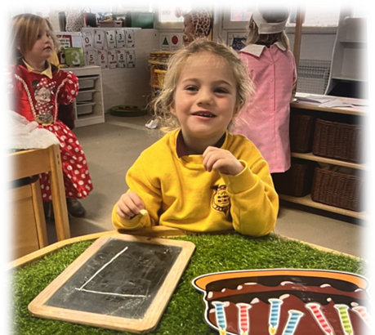
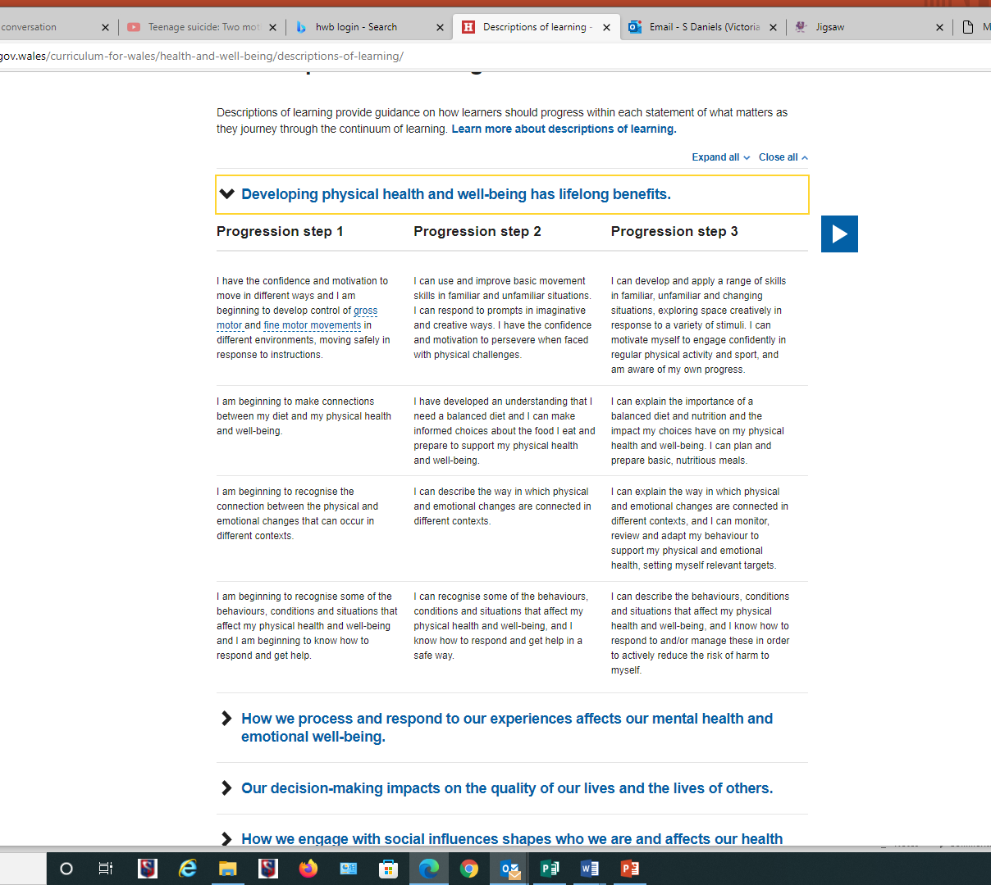
Descriptions of Learning
Notes:
Descriptions of learning provide guidance on how learners should progress within each statement of what matters as they journey through the continuum of learning. These are arranged in five progression steps which provide reference points for the pace of that progression. These expectations are expressed from the learner’s perspective and are framed broadly so that they can sustain learning over a series of years. They are not designed as stand-alone tasks, activities or assessment criteria. While the learning continuum is the same for each learner, the pace of progress through it may differ. As a result, the progression steps only broadly relate to age. They broadly correspond to expectations at ages 5, 8, 11, 14 and 16.

Slide 7
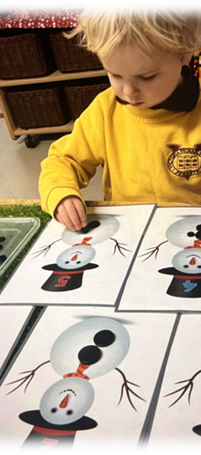
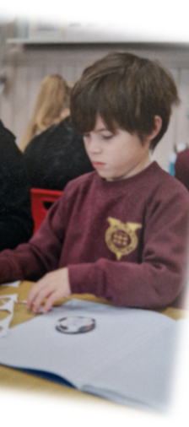
Progression Steps
Progression Step 1 – Nursery and Reception
Progression Step 2 – Year 1 – Year 3
Progression Step 3 – Year 4 – Year 6

Slide 8
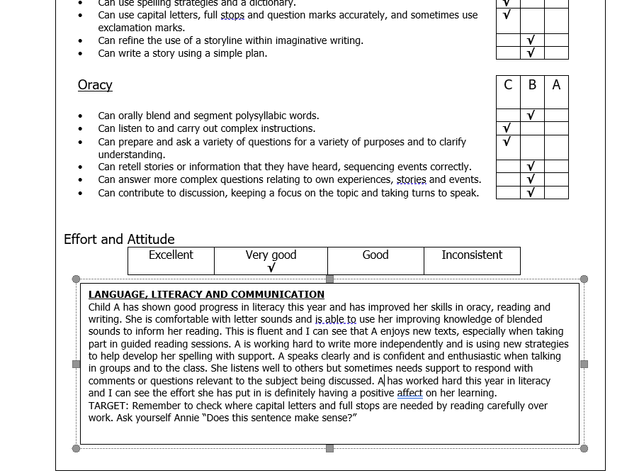
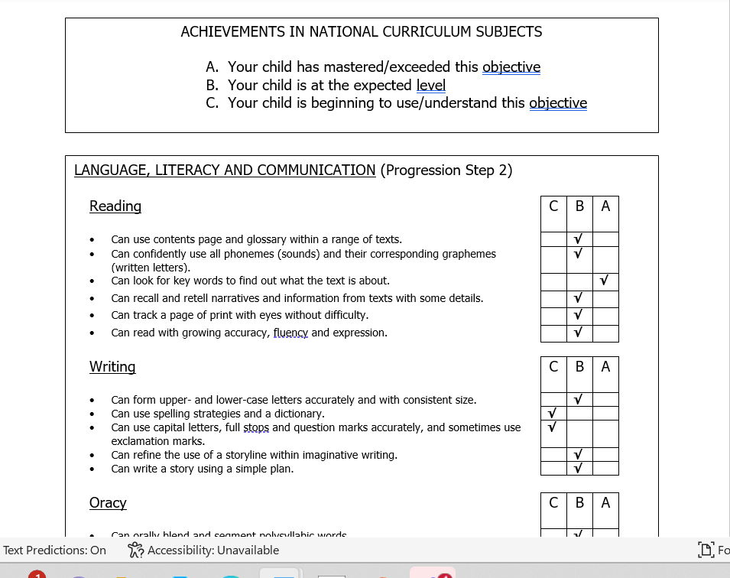
Report Content – Areas of Learning
Notes:
Each area of learning has a separate section on the report. In the core areas of LLC and MD , children also receive additional comments and a target. The progression step relate to the Curriculum for Wales Progression Steps as detailed on the previous slide. A tick by the letter C explains that you child needs support with this area, a B says they are able to do this particular skill and A means they are confident with that skill and able to apply it to a number of situations.

Slide 9
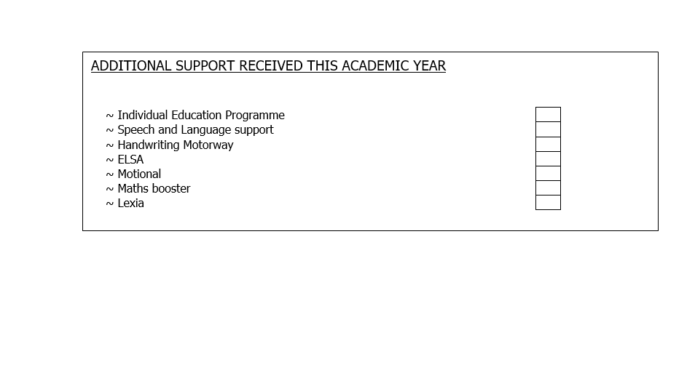
Report Content - Interventions
Notes:
Interventions vary across year groups. They are, in the main, short intervention programmes to plug gaps or build confidence.

Slide 10
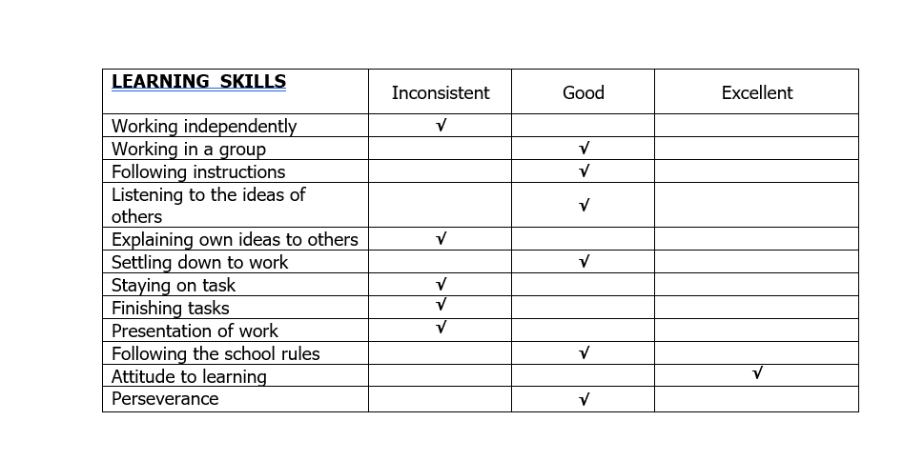
Report Content – Behaviours for learning
Notes:
The behaviours for learning are reflected in our school Relationship Policy. Inconsistent means that your child sometimes needs reminding, which can often be age related. Good is where we would like the children to be and excellent demonstrates exemplary behaviour.

Slide 11
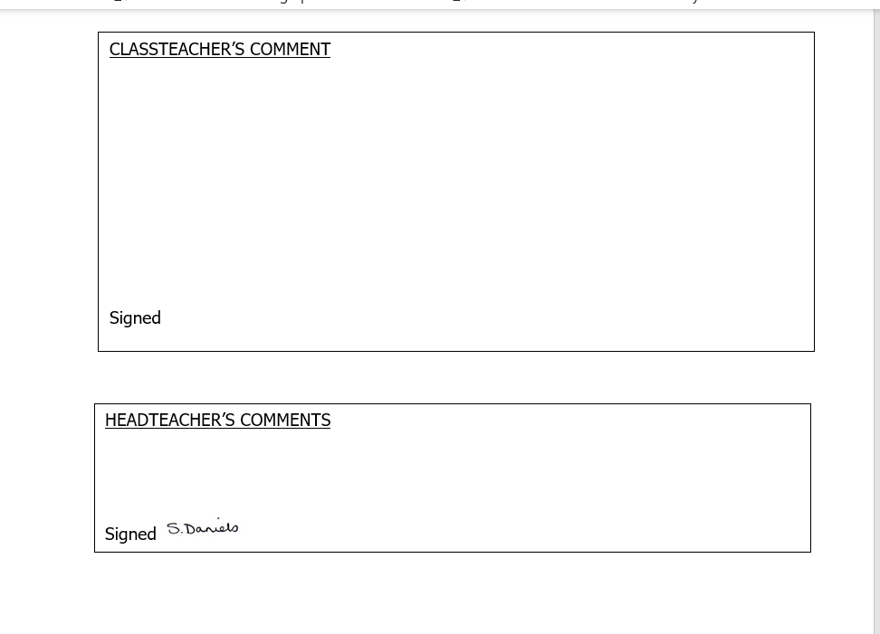
Report content - Comments
Notes:
The comments are personal to your child and highlight any main points that the teacher would like to bring to your attention.

Slide 12


