Slide 1
RSE in the New Curriculum
Autumn 2022

Slide 2
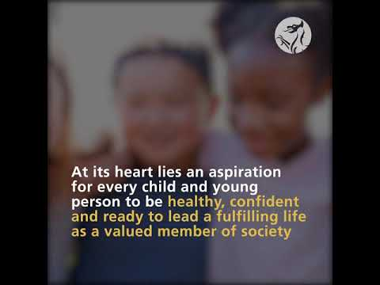

Slide 3

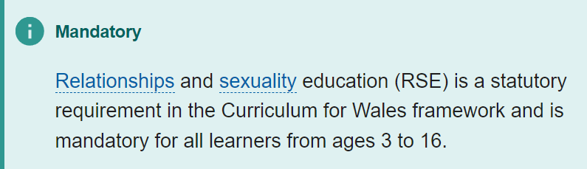
The RSE Code
The Code:
• gives clarity about what schools are legally required to include in their curriculum;
• helps schools make decisions about what learning is developmentally appropriate;
• gives transparency to parents and carers about what their children will learn about.

Slide 4
The RSE Code
Content within the RSE Code is set out in three broad and interlinked strands:
Relationships and identity - helping learners develop the skills they need to develop healthy, safe, and fulfilling relationships with others and helping them to make sense of their thoughts and feelings.
• Sexual health and well-being - helping learners to draw on factual sources regarding their sexual and reproductive health and well-being, allowing them to make informed decisions throughout their lives.
• Empowerment, safety and respect - helping to protect learners from all forms of discrimination, violence, abuse and neglect and enabling them to recognise unsafe or harmful relationships and situations, supporting them to recognise when, how and where to seek support and advice.

Slide 5
Three age phases
Content within each of the three strands is set out in three phases which have been designed to give practitioners an understanding of what is likely to be developmentally appropriate:
• Phase 1 - from age 3
• Phase 2 – from age 7
• Phase 3 – from age 11

Slide 6
Developmentally appropriate
RSE must be delivered in a way that is developmentally appropriate. This means that schools and settings need to take account of the following factors when deciding when to introduce content from the RSE Code:
a learner’s age
a learner’s knowledge
a learner’s maturity
any additional learning needs a learner may have
cognitive, emotional, physical, psychological and social development

Slide 7
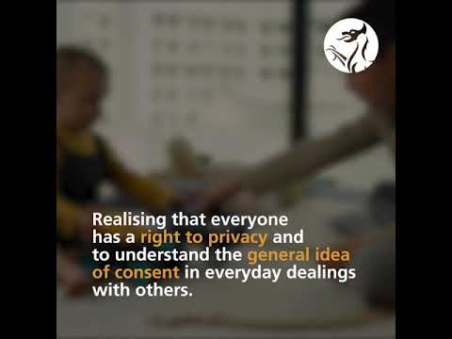
Common Misconceptions and Information from Owain Lloyd Director of Education

Slide 8
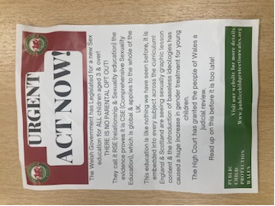
Common Misconceptions and Information from Owain Lloyd Director of Education
A common misconception is that learners will be taught about all the content within a particular strand from the beginning of a phase. This is not the case. Schools and settings need to carefully consider the continuum of learning within a particular phase, and sequence learning so that learners experience content in a way that is developmentally appropriate and builds upon their needs, experiences and existing and evolving knowledge of RSE.

Slide 9
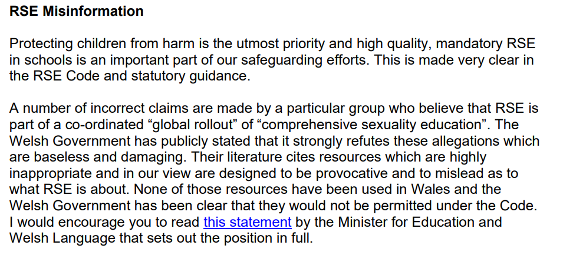
Common Misconceptions and Information from Owain Lloyd Director of Education

Slide 10
How Do We Deliver The Content of the RSE Curriculum at Victoria?
Jigsaw – whole school
Assemblies e.g. No Outsiders – whole school
Show Racism the Red Card – whole school
Spectrum workshops – Y2 and Y6
Police Community Workshops – Rec – Y6
Anti-Bullying Week – whole school
E-Safety Week – whole school
Whole school theme week ‘This Is Me’ – whole school

Slide 11
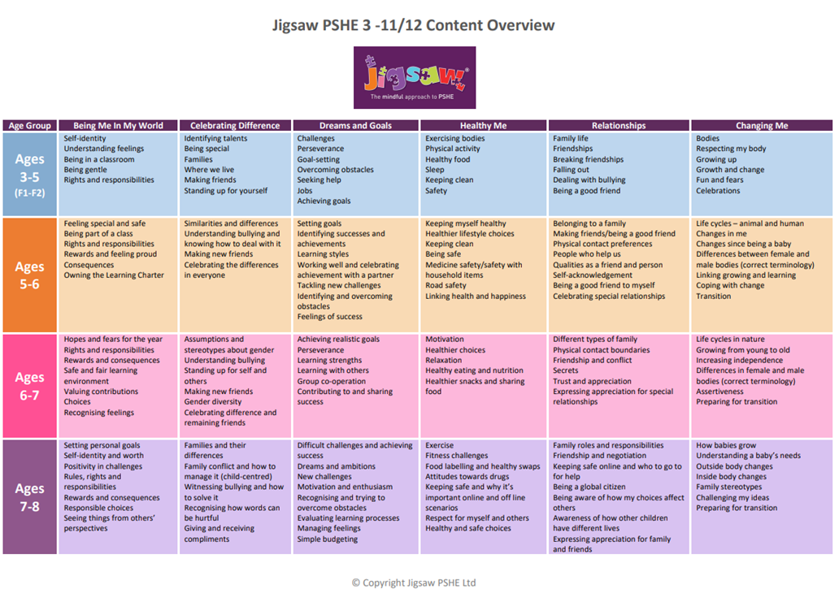

Slide 12
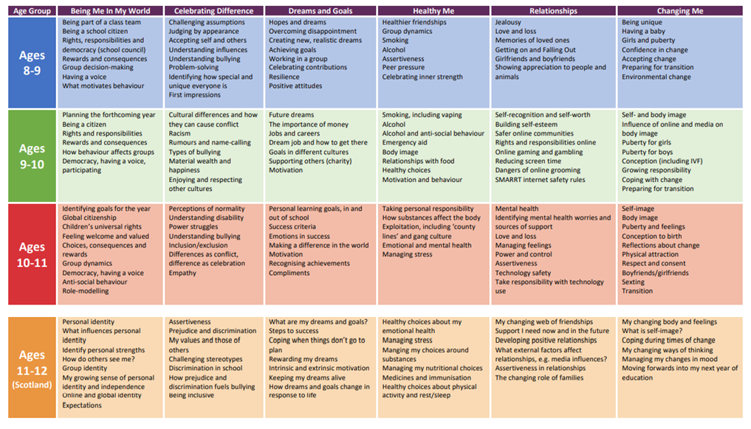

Slide 13
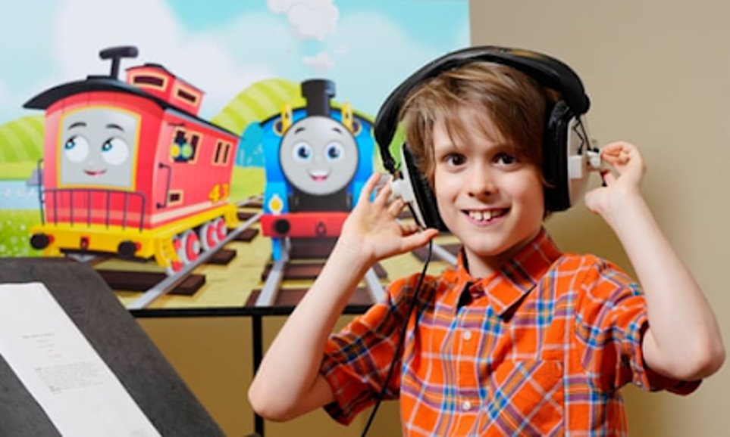
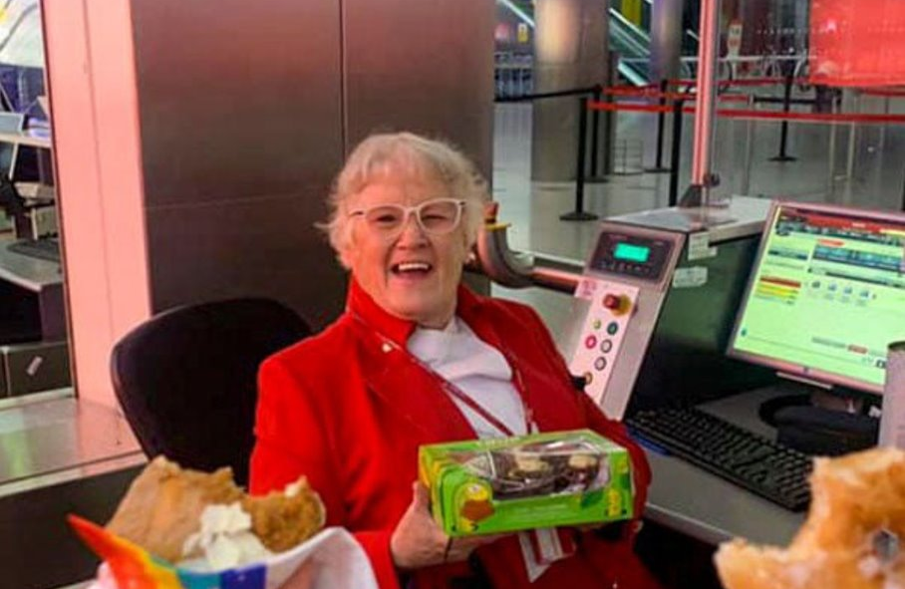
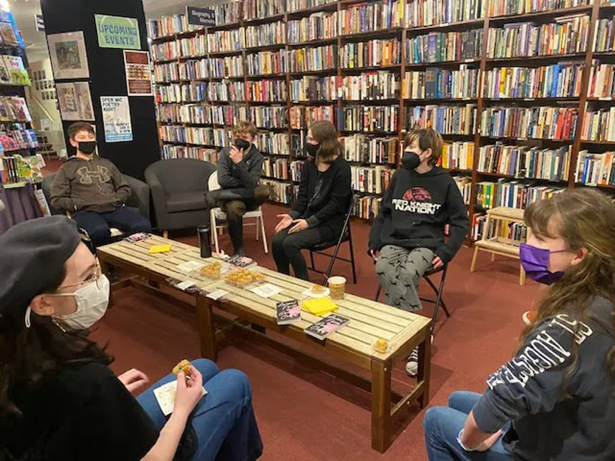

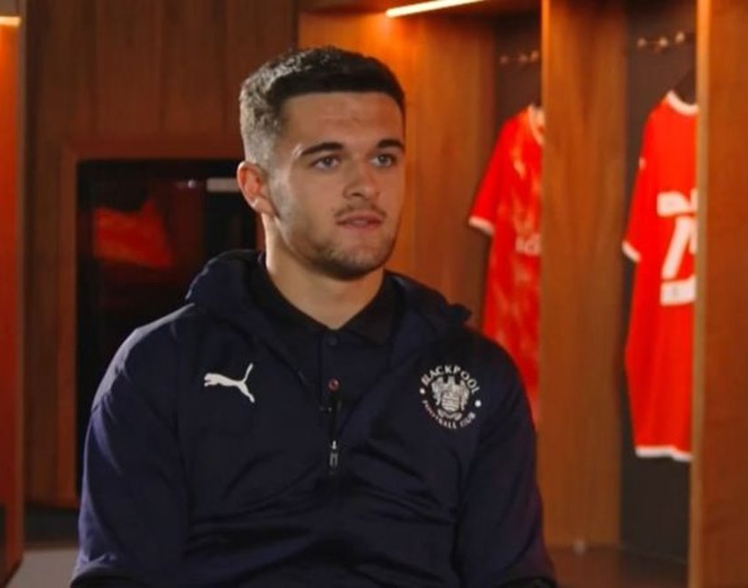

Slide 14
Whole school coverage
https://hwbwave15.sharepoint.com/:x:/r/sites/673/victoria/_layouts/15/Doc.aspx?sourcedoc=%7BEB1D268F-F5BB-4FA2-BB4D-255421F3FC3B%7D&file=RSE%20CODE%20CURRICULUM%20MAPPING%20TOOL.xlsx&action=default&mobileredirect=true

Slide 15
Possible Activities from Jigsaw Lessons
Jigsaw (jigsawpshe.online)
Year 1 – Changing Me – Boys' and girls' bodies
Year 2 – Relationships - Accept that everyone’s family is different and understand that most people value their family
Year 3 – Changing Me – Outside and inside body changes
Year 4 – Healthy Me - understand there are people who take on the roles of leaders or followers in a group, and to know the role I take on in different situations
Year 5 – Changing Me – Being aware of my own self-image
Year 6 –Being Me - I know that there are universal rights for all children but for many children these rights are not met

Slide 16
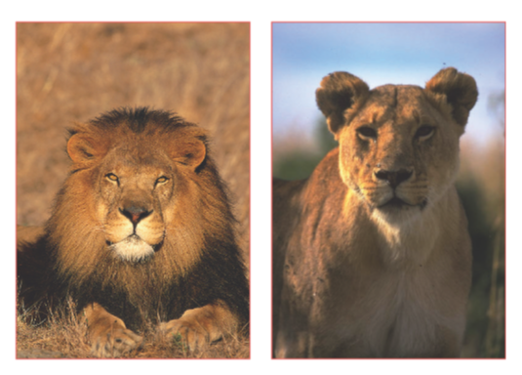
Year 1 – Changing Me – Boys' and girls' bodies
Year 2 – Relationships - Accept that everyone’s family is different and understand that most people value their family
Year 3 – Changing Me – Outside and inside body changes
Year 4 – Healthy Me - understand there are people who take on the roles of leaders or followers in a group, and to know the role I take on in different situations
Year 5 – Changing Me – Being aware of my own self-image
Year 6 –Being Me - I know that there are universal rights for all children but for many children these rights are not met

Slide 17

Year 1 – Changing Me – Boys' and girls' bodies
Year 2 – Relationships - Accept that everyone’s family is different and understand that most people value their family
Year 3 – Changing Me – Outside and inside body changes
Year 4 – Healthy Me - understand there are people who take on the roles of leaders or followers in a group, and to know the role I take on in different situations
Year 5 – Changing Me – Being aware of my own self-image
Year 6 –Being Me - I know that there are universal rights for all children but for many children these rights are not met

Slide 18
Year 1 – Changing Me – Boys' and girls' bodies
Year 2 – Relationships - Accept that everyone’s family is different and understand that most people value their family
Year 3 – Changing Me – Outside and inside body changes
Year 4 – Healthy Me - understand there are people who take on the roles of leaders or followers in a group, and to know the role I take on in different situations
Year 5 – Changing Me – Being aware of my own self-image
Year 6 –Being Me - I know that there are universal rights for all children but for many children these rights are not met

Slide 19
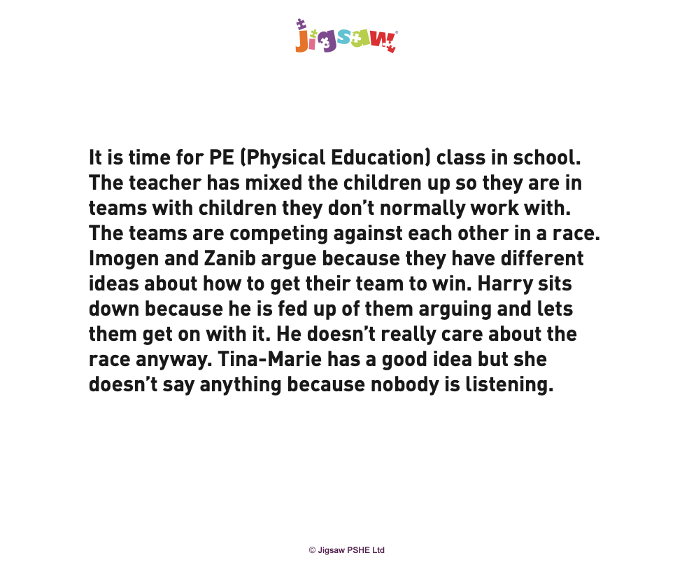
Year 1 – Changing Me – Boys' and girls' bodies
Year 2 – Relationships - Accept that everyone’s family is different and understand that most people value their family
Year 3 – Changing Me – Outside and inside body changes
Year 4 – Healthy Me - understand there are people who take on the roles of leaders or followers in a group, and to know the role I take on in different situations
Year 5 – Changing Me – Being aware of my own self-image
Year 6 –Being Me - I know that there are universal rights for all children but for many children these rights are not met

Slide 20
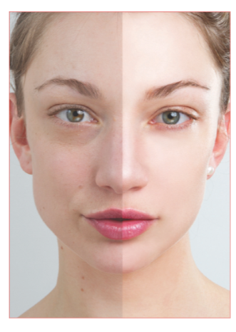
Year 1 – Changing Me – Boys' and girls' bodies
Year 2 – Relationships - Accept that everyone’s family is different and understand that most people value their family
Year 3 – Changing Me – Outside and inside body changes
Year 4 – Healthy Me - understand there are people who take on the roles of leaders or followers in a group, and to know the role I take on in different situations
Year 5 – Changing Me – Being aware of my own self-image
Year 6 –Being Me - I know that there are universal rights for all children but for many children these rights are not met

Slide 21
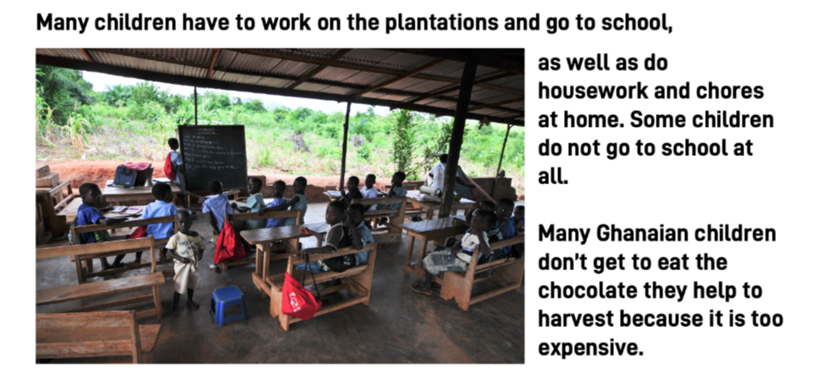
Year 1 – Changing Me – Boys' and girls' bodies
Year 2 – Relationships - Accept that everyone’s family is different and understand that most people value their family
Year 3 – Changing Me – Outside and inside body changes
Year 4 – Healthy Me - understand there are people who take on the roles of leaders or followers in a group, and to know the role I take on in different situations
Year 5 – Changing Me – Being aware of my own self-image
Year 6 –Being Me - I know that there are universal rights for all children but for many children these rights are not met

Slide 22

Any Questions?

