Slide 1
Parent Meeting
Anti-racist Action Plan
Mrs Daniels & Mrs Brown

Slide 2
To ensure effective provision for supporting well-being, equity and inclusion

Slide 3
Rationale
As part of our self-evaluation process we identified the need to find effective ways to ensure that provision supports well-being, equity and inclusion. As a result, the school improvement plan identifies action research plans as a way to investigate and embed best practice. The school is working with a variety of agencies to support us in developing a decolonised curriculum that reflects all our children, their families and our community and fosters a sense of belonging.

Slide 4
Video
https://bit.ly/2v2I6SY

Slide 5
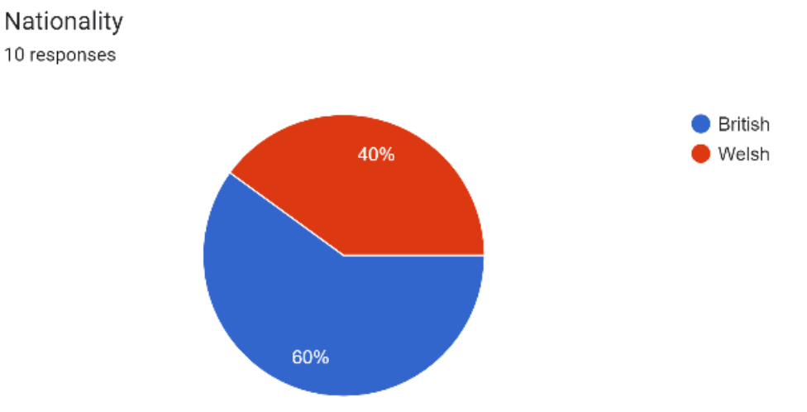
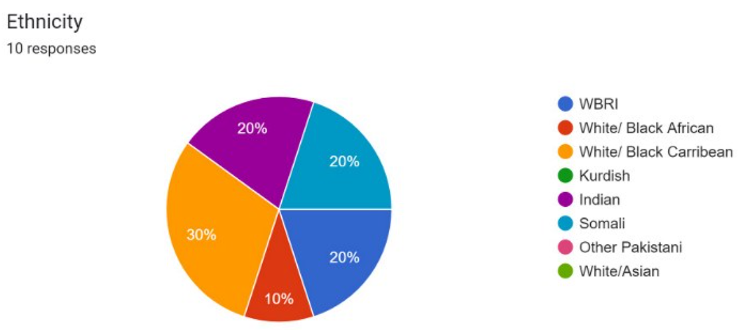
Results from the children's diversity and inclusion baseline questionnaire

Slide 6
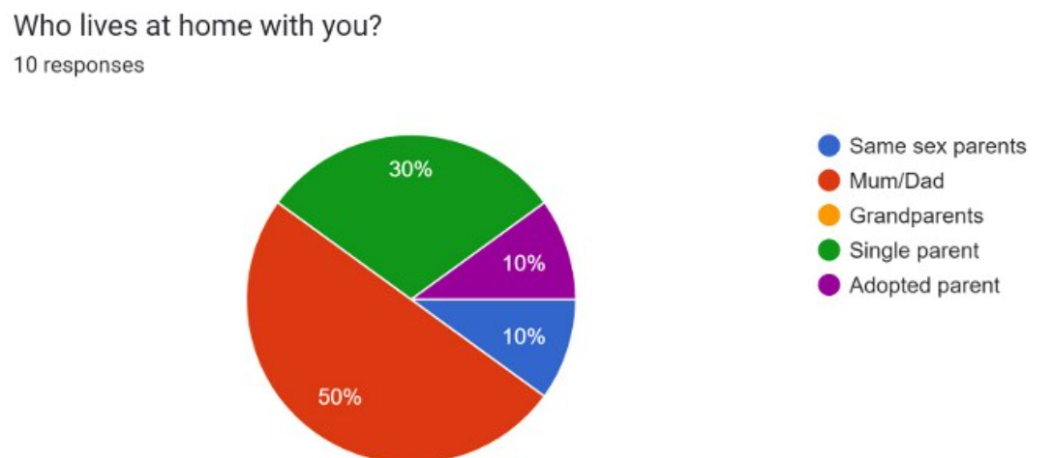
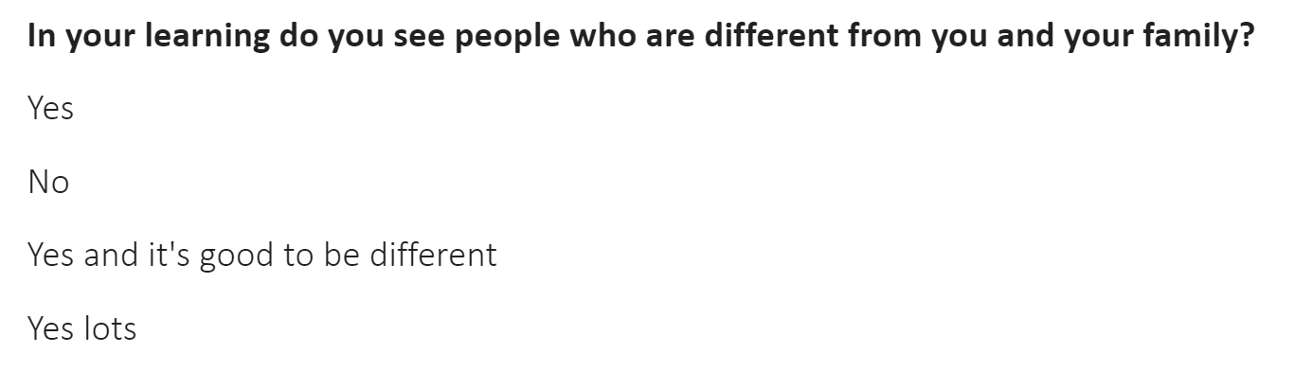

Slide 7
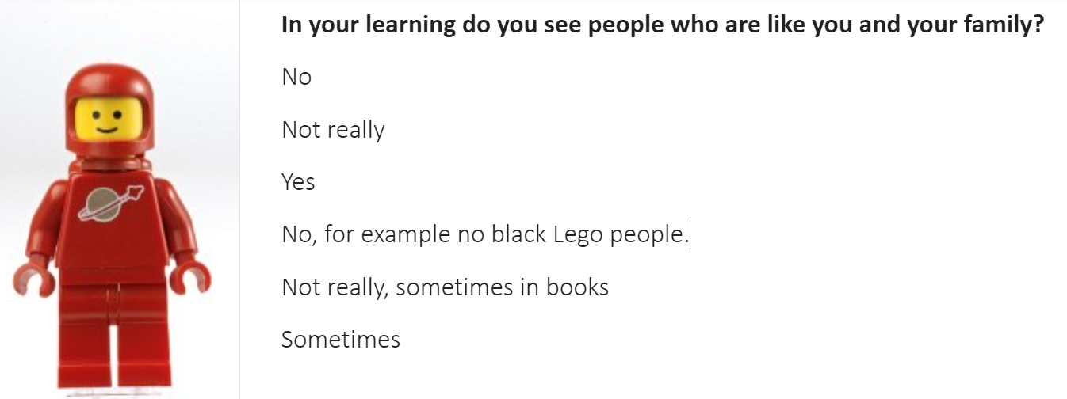
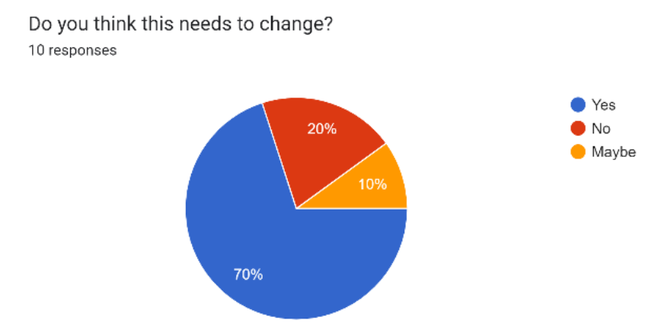

Slide 8
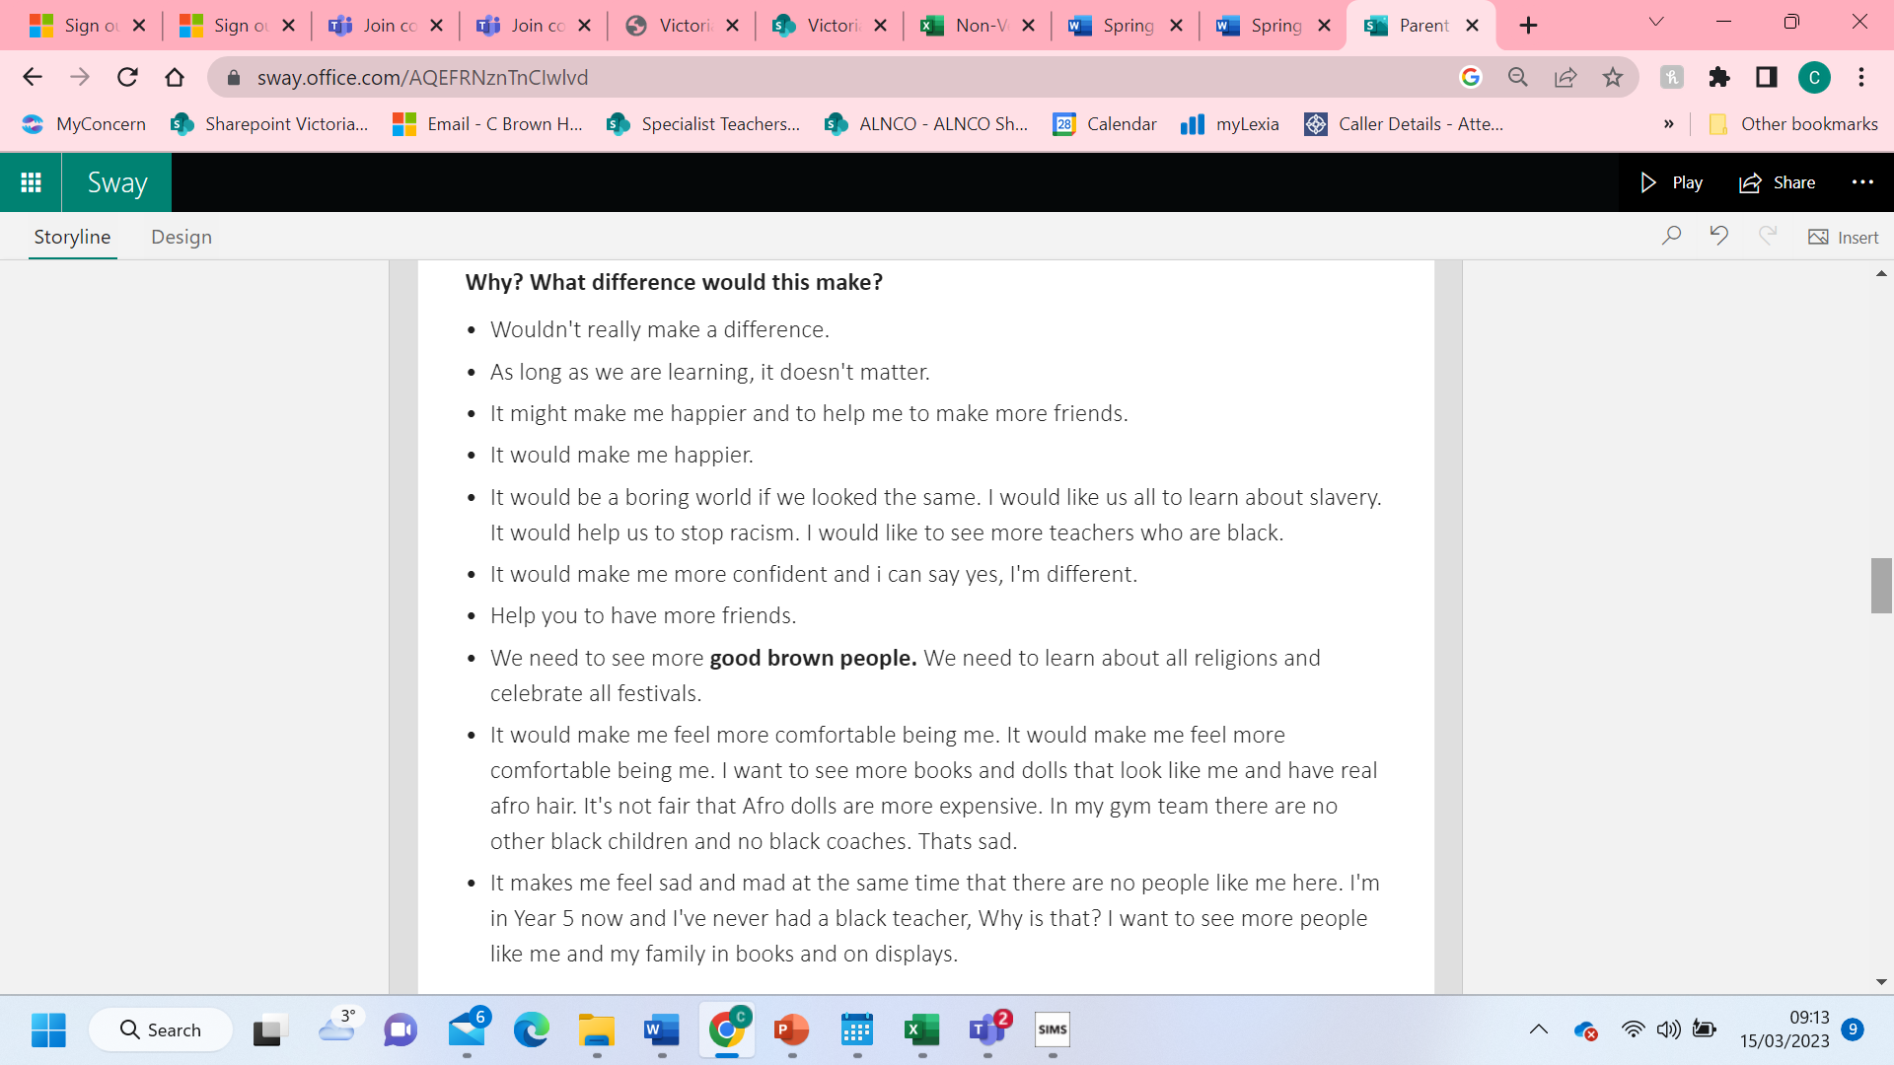

Slide 9
In your learning do you see people who are like you and your family?
No
Not really
Yes
No, for example no black Lego people.
Not really, sometimes in books
Sometimes

Slide 10
Why? What difference would this make?
Wouldn't really make a difference.
As long as we are learning, it doesn't matter.
It might make me happier and to help me to make more friends.
It would make me happier.
It would be a boring world if we looked the same. I would like us all to learn about slavery. It would help us to stop racism. I would like to see more teachers who are black.
It would make me more confident and i can say yes, i'm different.

Slide 11
Why? What difference would this make?
Help you to have more friends.
We need to see more good brown people. We need to learn about all religions and celebrate all festivals.
It would make me feel more comfortable being me. It would make me feel more comfortable being me. I want to see more books and dolls that look like me and have real afro hair. It's not fair that afro dolls are more expensive. In my gym team there are no other black children and no black coaches. That’s sad.
It makes me feel sad and mad at the same time that there are no people like me here. I'm in year 5 now and I've never had a black teacher, why is that? I want to see more people like me and my family in books and on displays.

Slide 12
BASELINE QUESTIONS
Foundation Phase
What is racism?
Yr3 - Yr6
How do know when someone is Welsh?
What does being Welsh mean to you?

Slide 13
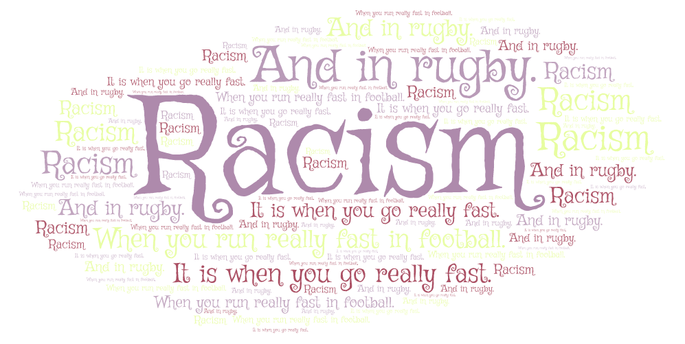

What is Racism?

Slide 14
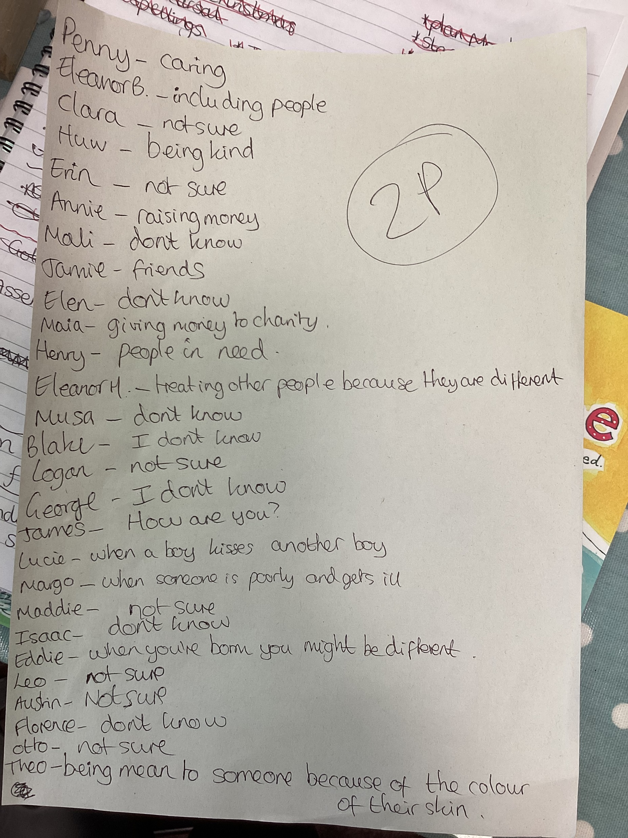
What is Racism?

Slide 15
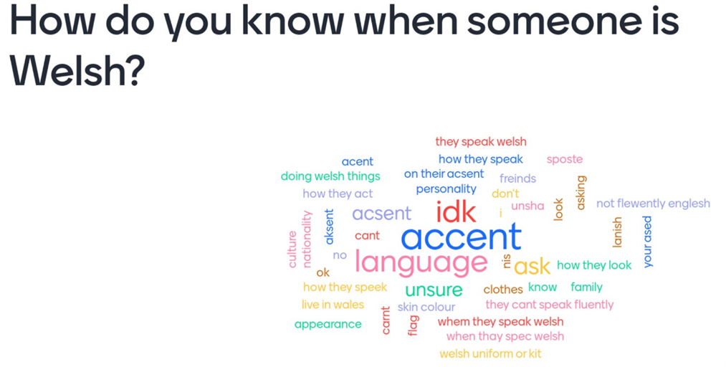

Slide 16
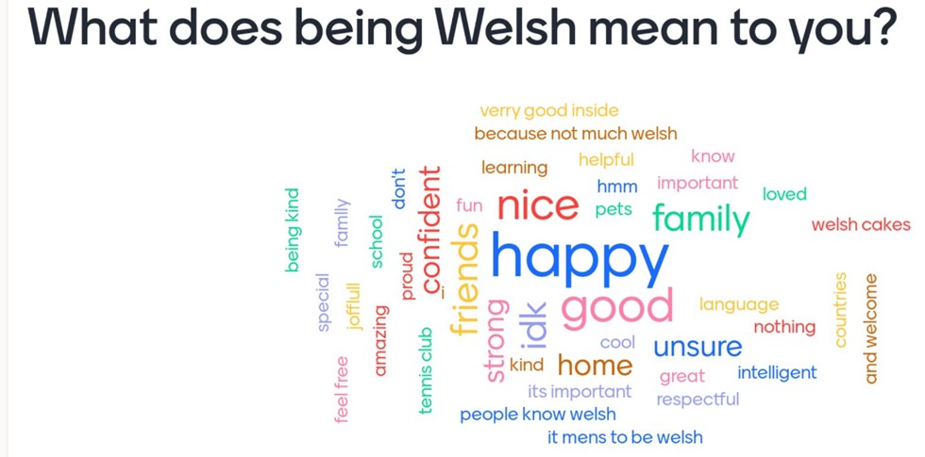

Slide 17
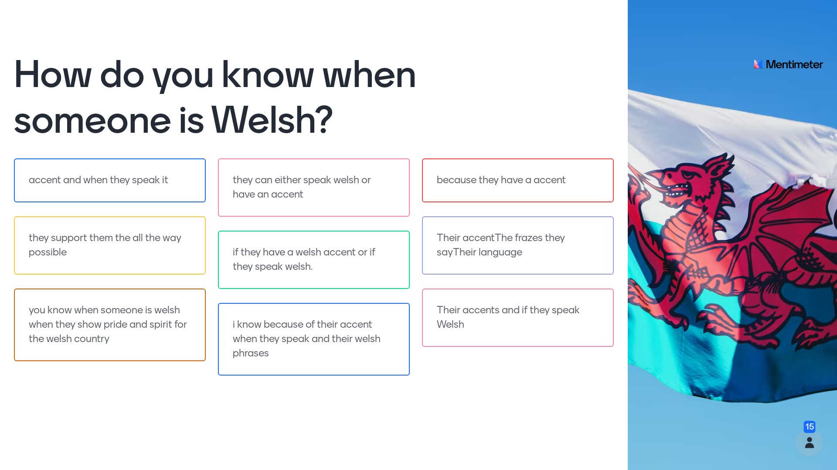

Slide 18
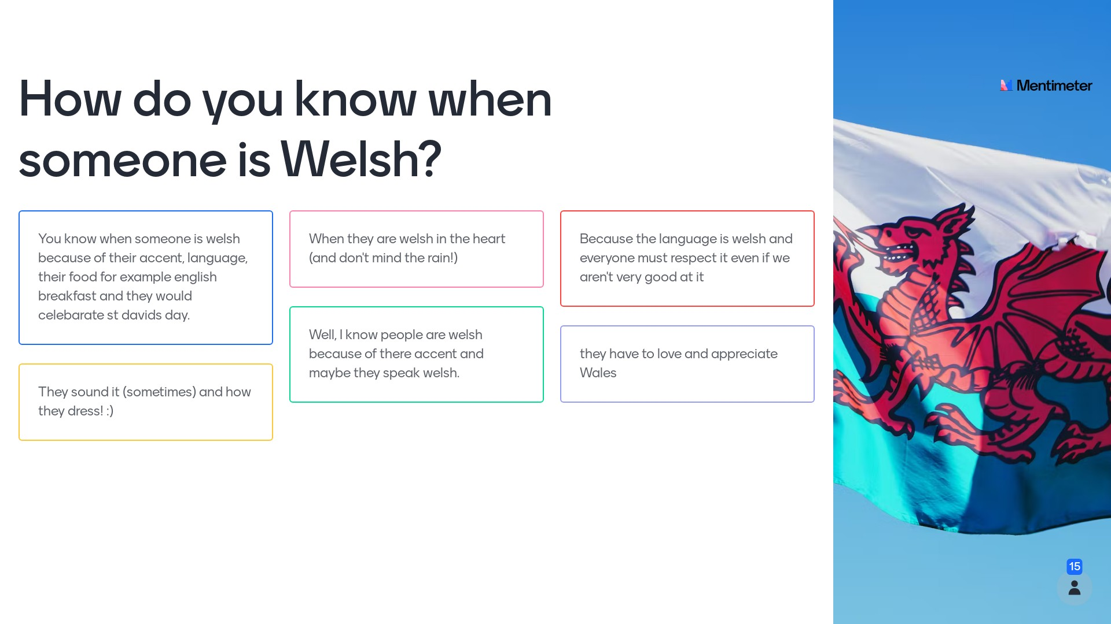

Slide 19
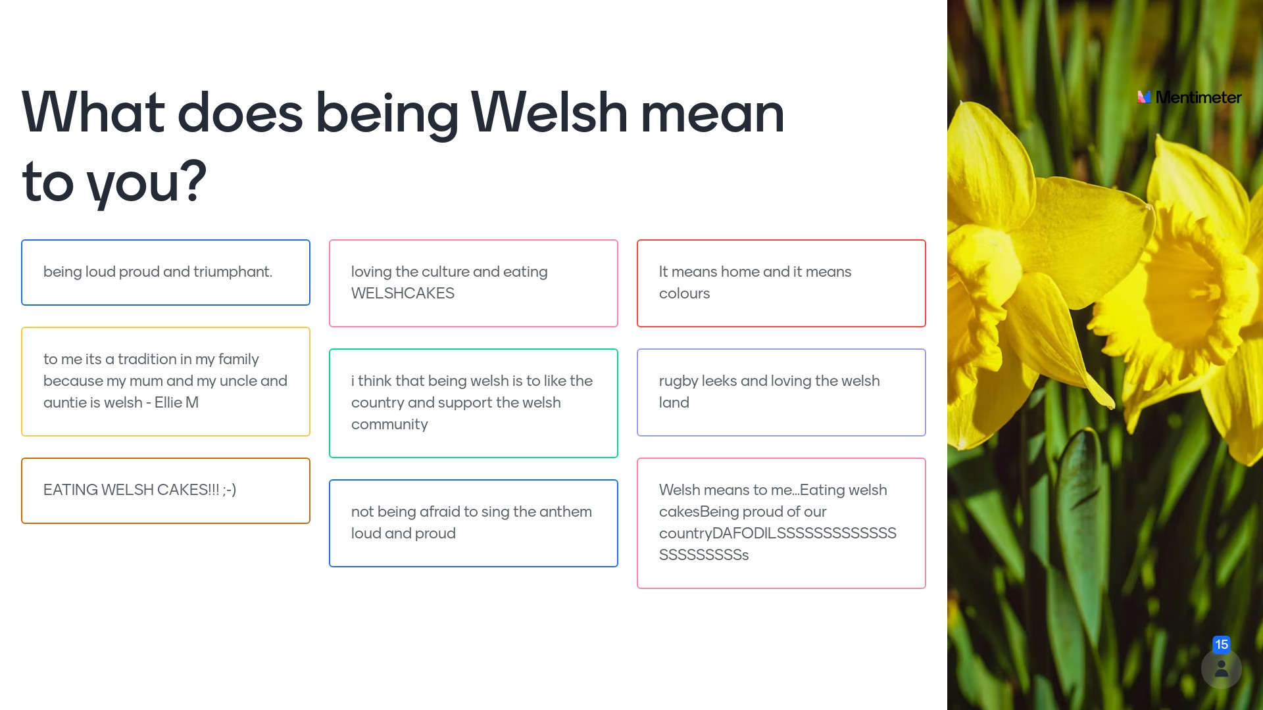

Slide 20
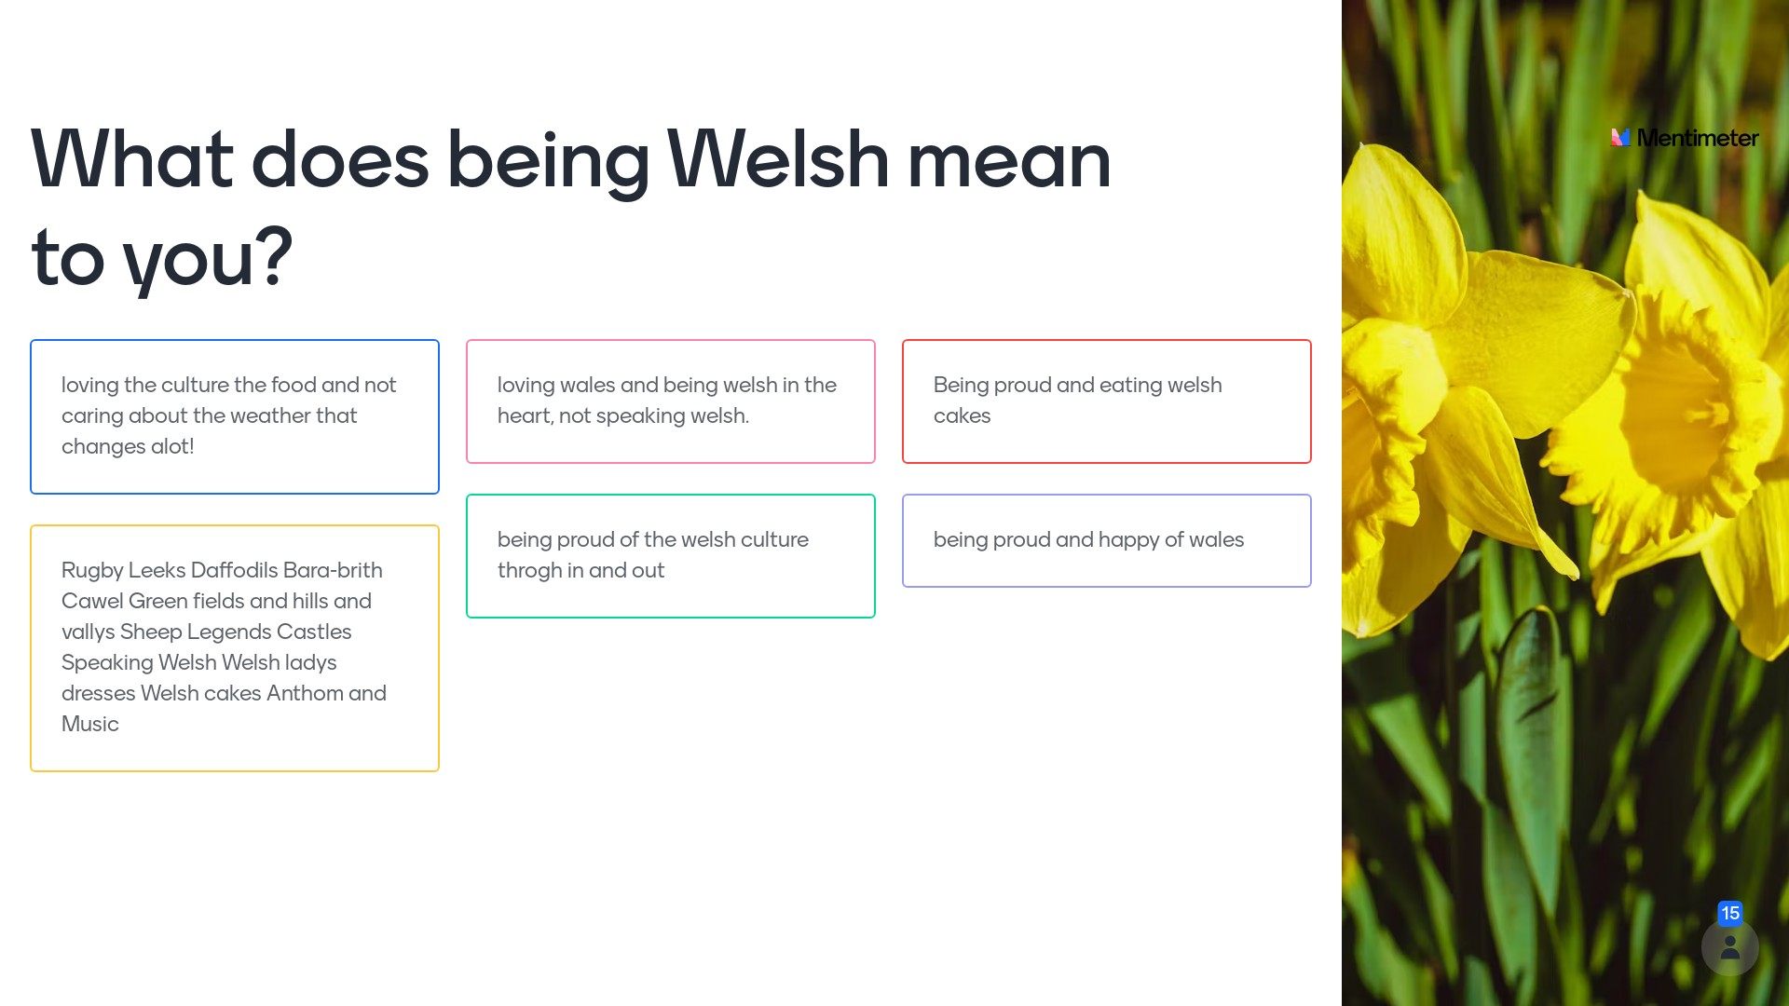

Slide 21
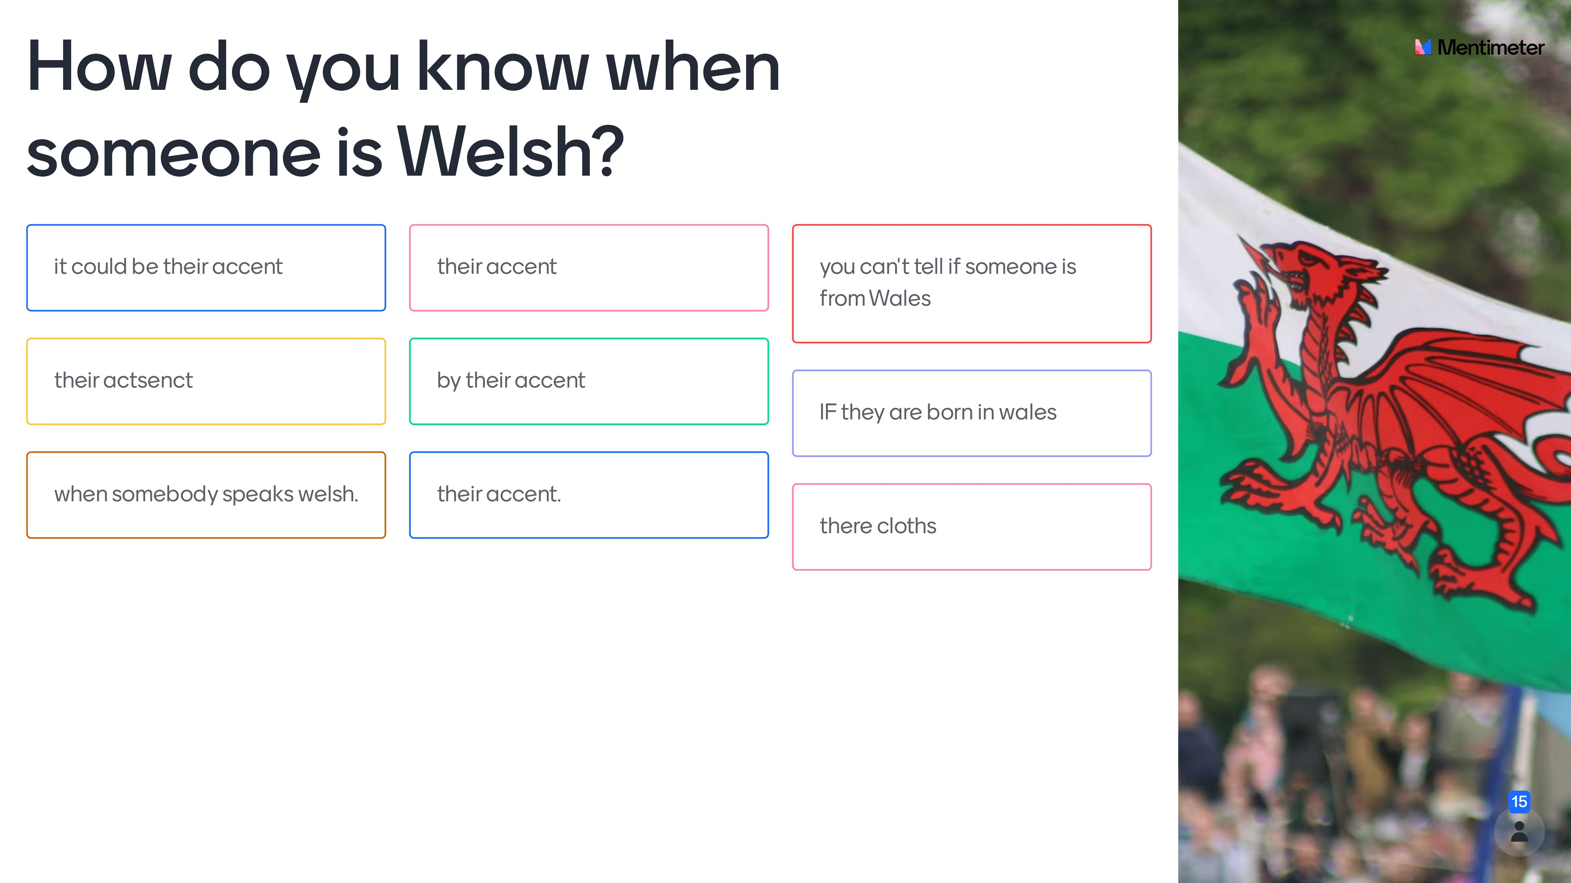

Slide 22


Slide 23




