Slide 1

Foundation Phase Numeracy Parent Workshop 2020

Slide 2
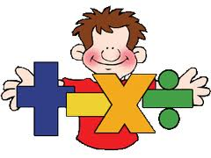
Aim of the session:
To gain an understanding of ‘what’ and ‘how’ we teach Numeracy in our school.

Slide 3
Numeracy in our school
We follow the Programmes of Study that outline the learning for each year group.
We don’t use one scheme, we use a variety of resources, schemes and programmes, including practical activities to support learning and deepen understanding.
Tapas is used as our daily mental warm up.
Skills, application and reasoning form the elements of our weekly numeracy lessons.

Slide 4
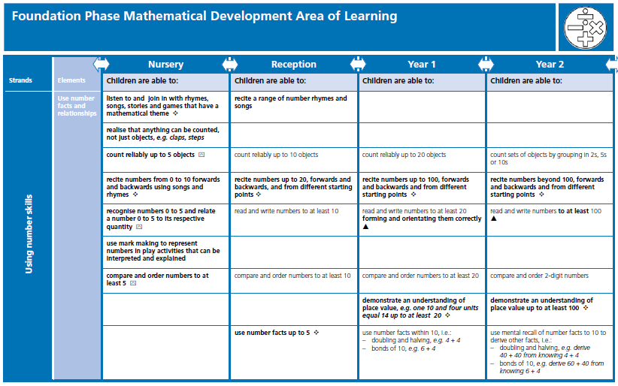
Progression of skills

Slide 5

It is the equivalent of a ‘letters and sounds’ phonics approach for teaching the basic skills of reading.

Slide 6
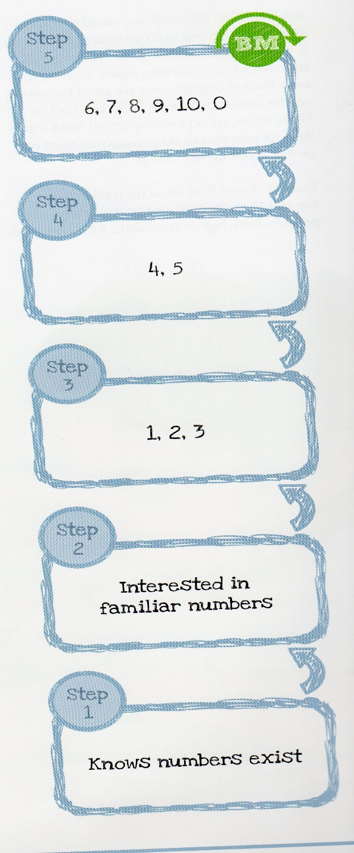
The Progress Drives, Drive Progress! Progress Drives are nothing more than a simple sequence of progression.
It’s about thinking my children can do this, so I’m going to get them to do this next, and then I’m going to get them to do that!”

Slide 7
In the Foundation Phase…
We teach through songs, rhymes, dance, story books, role play situations, games, jigsaws, whole class teaching, small group activities, 1:1 support, inside activities, outside activities, learning walls, craft activities, iPad and computer programmes and anything else we can think of.

Slide 8
We strongly believe that whilst children do need to learn through play they also need direct teacher input. We want the children to explore, self discover and be creative in their play but all those features of play have to be built on a knowledge base. You can’t play mermaids if you’ve never seen or heard of a mermaid any more than you can play at shops if you’ve no idea about coins or pennies or counting.
In the first term of Reception, we spend time on learning the correct number formation and conservation of number.
Notes:
Level 3 step 21 80+90 17 tens / step 30 £2.41 + £ 3.53 add £ T p = L4 L5 step 41 8.67 + 9.8

Slide 9
Tapas
Teacher, assess, plan, achieve, succeed.
Our Sessions begin with:
As a school we invested in whole school training and key resources that are progressive throughout the school.
Teachers plan for a wide range of activities and used them effectively to develop pupils’ mental skills.
We need to equip pupils with sufficient strategies to quickly and efficiently derive other facts from them.
As pupils develop a wider range of known facts, so the range of strategies available to them for deriving facts also grows.
This ensures progress and develops understanding so our
children can be confident and numerate.

Slide 10
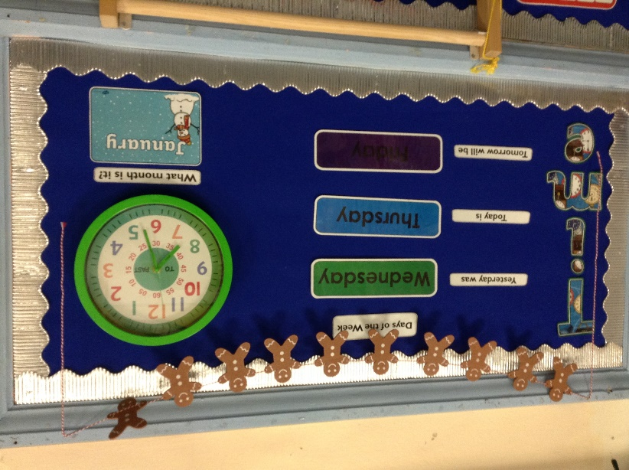
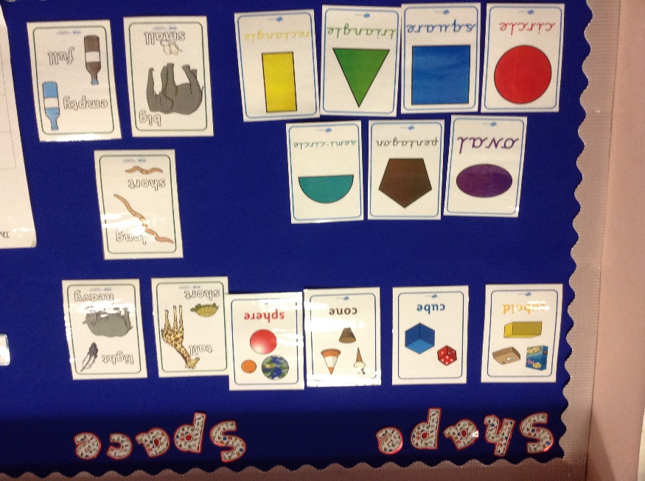
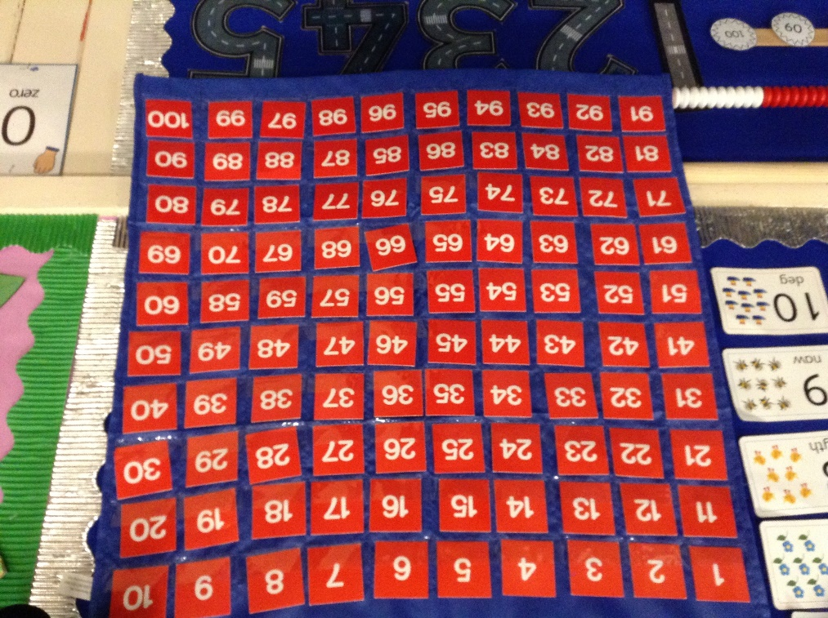
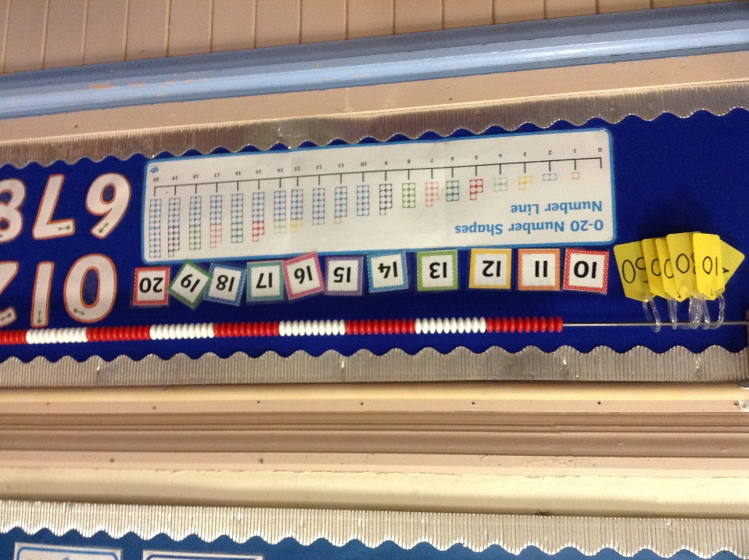

Slide 11

Next we have a teacher led carpet session where new skills and learning are introduced and developed.
This is followed by book time. A time to sit down and write and record numbers, practise the newly learnt skills, carry out practical calculations and count with one to one correspondence etc.
Or a chance to practice the skills
in a more practical way.

Slide 12

Continuous and Enhanced activities are provided and ongoing, to allow the children to play and develop the skills they’ve been learning.

Slide 13
Cross Curricular Maths
We apply the skills through a variety of Cross Curricular experience.
Use children’s experiences.
As much as possible, we base problems on children’s everyday experiences at school. Plenty of experience of maths in ‘real life’ contexts: shopping, cooking, reading calendars and timetables enhances and deepens their understanding.

Slide 14
Numerical Reasoning
The ability to transfer Mathematical knowledge to a variety of situations is critical to our children’s future.
By applying mathematics to problem solving, children begin to understand why they need to know their basic facts.

Slide 15
What is Reasoning?
Several different questions can be useful in probing learners’ thinking.
Why do you think that . . . ? What explanation do you think is best . . . ?
Can you explain why that is right? Is there another way . . . ?
How do you know? Have you tried all the possible cases?
How did you reach that conclusion? Does it always work? Why?
What might explain that . . . ? How is that possible?
Can you show me . . . ? What do you notice when . . . ?

Slide 16
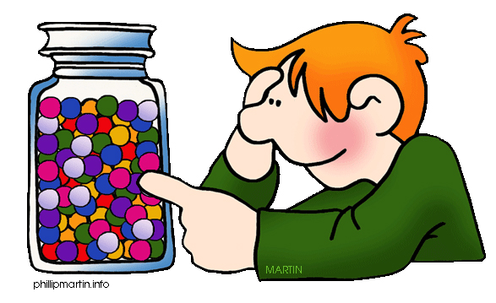
Different types of problem solving:
● Using equipment and acting out
● Drawing a picture
● Finding all the possibilities
● Logical reasoning
● Working backwards
● Open ended problems
Notes:
Using a table
Looking for a pattern
Working backwards

Slide 17
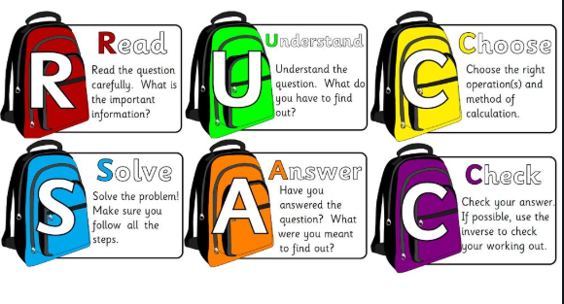
Model used throughout school to support reasoning & problem solving

Slide 18
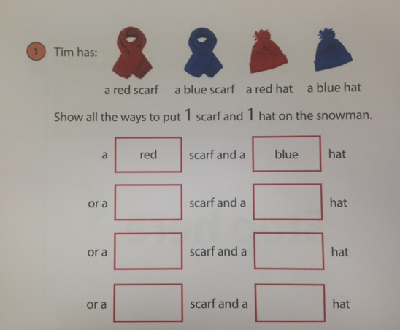
Year 2 Reasoning

Slide 19
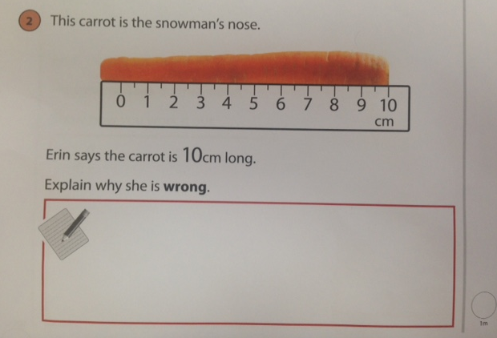
Year 2 Reasoning

Slide 20
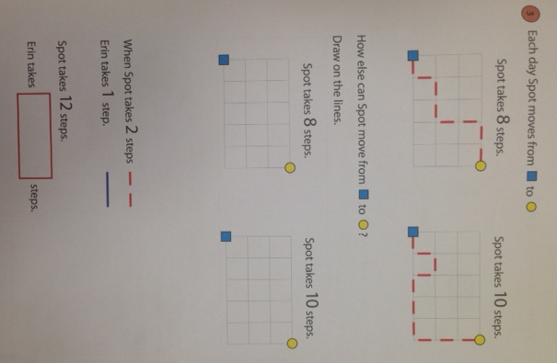

Slide 21
How Can Parents with Reasoning?
Provide time and talk about problem solving.
Be patient with your child. Let them work at their own pace. Talk, talk, talk! Encouraging children to explain what they are doing at different stages of a calculation and to estimate answers first. Talk about options, strategies and ideas for problem solving.
Use children’s experiences.
As often as possible, base problems on children’s everyday experiences at school and at home. Plenty of experience of maths in ‘real life’ contexts: board games, shopping, cooking, reading calendars and timetables.

Slide 22
Is there anything else we can do to help our children love numbers and Math?

Slide 23
Regularly practice number facts.
Reinforce risk taking and reward perseverance. Instant success is not always possible in problem solving. Children need a great deal of security to risk being wrong. Encourage children to keep trying by asking them questions that will lead them in the right direction.
Reinforce what is outlines on the Helping Hand worksheet. These should be quick activities to support class learning.

Slide 24
Progression of Times Tables
Year 2 | Year 3 | Year 4 | Year 5 | Year 6
2s 5s 10s | 2s 3s 4s 5s 10s | 2s 3s 4s 5s 6s 10s | 2s 3s 4s 5s 6s 8s 10s | All tables up to 10x10

Slide 25
Yes there is one more thing……
Count! Count! Count! Count everywhere.
Stairs up to bed, plates on the table, knives, forks and spoons…how many do we need? How many are there altogether?
Toys in the toybox… take some out. How many now?
How many for dinner tonight? So how many plates do I need?
Puzzles!

Slide 26
Count forward….. Count backwards….
Count on from different starting places
Count backwards from different starting places
Count in 2s, 5s, 10s
Count to 100 and back
Look for numbers on buses, houses, clocks, pages, talk about what number would be next? Came before? If you added to it? Took from it? Shared it? etc

Slide 27
Next Steps
New curriculum- more creative way but standards can’t be lost.
Useful Websites
Are on the back of the Curriculum overviews when you receive them each term.

Slide 28


