Slide 1

Year 4
Curriculum Meeting

Slide 2

Welcome, Croeso!
Thank you for coming to this parent’s information meeting.
We hope that your child has both a positive and rewarding experience during their time in Year 4.
Please feel free to ask any questions at the end of this presentation.

Slide 3

Our Team
4WH
Mrs Wason (Monday - Wednesday)
Mr Husband (Thursday & Friday)
4GW
Mrs Glover (Monday - Thursday)
Mrs Wason (Friday)
PPA Wednesday pm
4WH Mrs Orefice
4G Mrs Hatton
ALNco – Mrs Hall

Slide 4

Curriculum for Wales

Slide 5
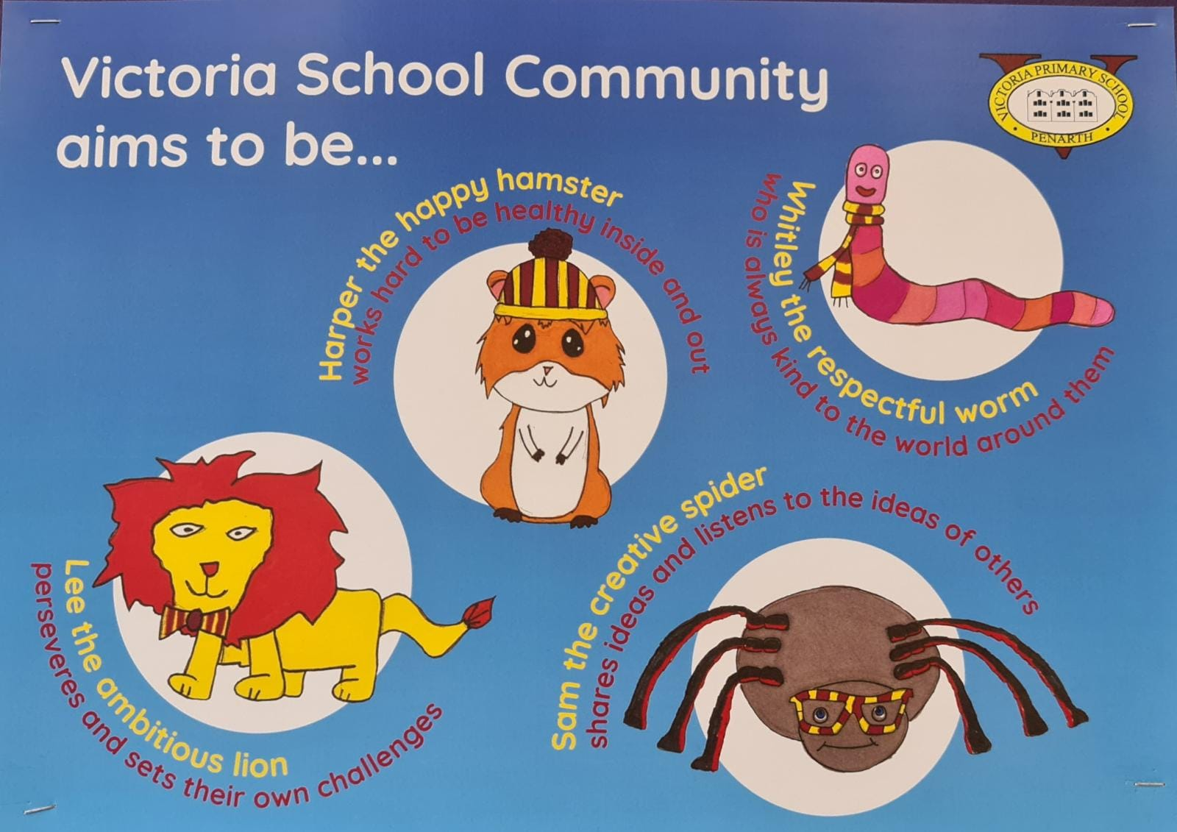

Slide 6

Curriculum Overview
Termly
Overview of what we hope to cover
Trips and Visitors
Links to topic websites

Slide 7

Autumn Term
This term Year 4 will be focusing on Humanities

Slide 8
Pupil’s Ideas!
Before each topic we always ask the children what they would like to learn. We try to incorporate as many of these ideas as we can when planning our lessons so that the children have the opportunity to ‘follow their interests.’ Some of their ideas were …
How did they pay for things?
What did they eat and drink?
Where did they live? / Where did they sleep?
What transport did they use?
What did they do in their spare time?
Why did they want conflict?
Did the Romans lie a lot?

Slide 9
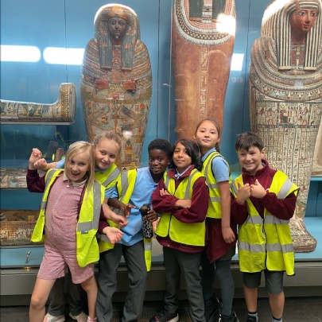
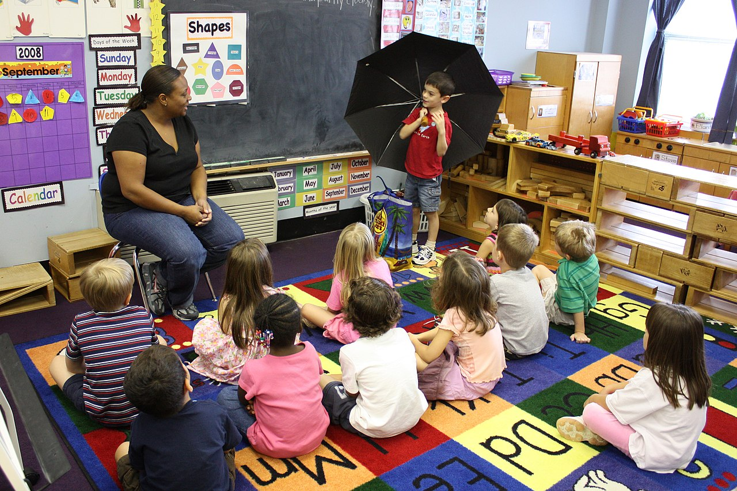
Educational Visits and
Parent Support
We aim for children to undertake educational visits wherever possible. If you have an interest / occupation linked to any of our topics this year and would like to talk to the class about it, please see your child’s class teacher.
.

Slide 10
Uniform
Grey trousers / shorts / skirt, summer dresses
Yellow polo shirt
Burgundy sweatshirt / jumper
Black, sensible shoes
Long hair tied back
No jewellery, apart from watches (no smart watches) and stud earrings.

Slide 11
P.E. Kit
To be worn to school on designated P.E days.
MONDAY (indoor) and FRIDAY (outdoor)
Plain white t-shirt
Black bottoms (shorts, joggers, leggings, skorts)
To be worn with a school jumper or cardigan or plain black top.

Slide 12


Snack

Slide 13
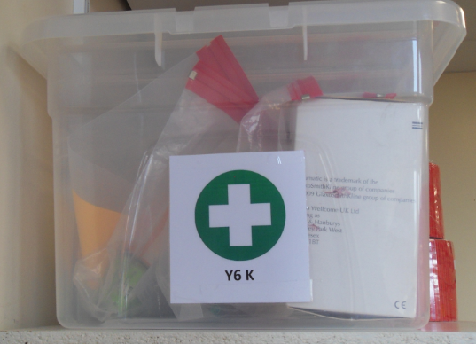
Medical information
We are only allowed to give prescribed medicines from the doctor. All medicines should be in date and clearly labelled. Medical forms must be signed and handed in with the medication.

Slide 14
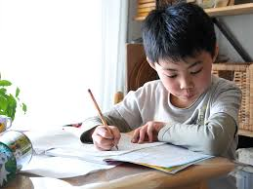
Homework
Feedback from our school 'Curriculum Task Group' research has shown us that parents and children value the current homework expectations at Victoria.
Homework will be posted on Google Classrooms and is called 'Y4 Homework 25-26'. The assignments will include instructions and links appropriate to the homework.

Slide 15
What we expect the children to do at home:
Multiplication tables: We are looking for accuracy and speed. All children can log in at home and at school to TTRS
Mental Maths: encourage these skills during everyday life – shopping, telling the time, reading TV timetables, cooking etc.
Reading: This can be independent reading, shared reading and / or children being read to by an adult. Comprehension of the text is as important as phonetic understanding, so it is valuable to discuss the text whenever possible.
Other Homework will be discussed in class before being posted on Google Classroom, for example spellings.

Slide 16
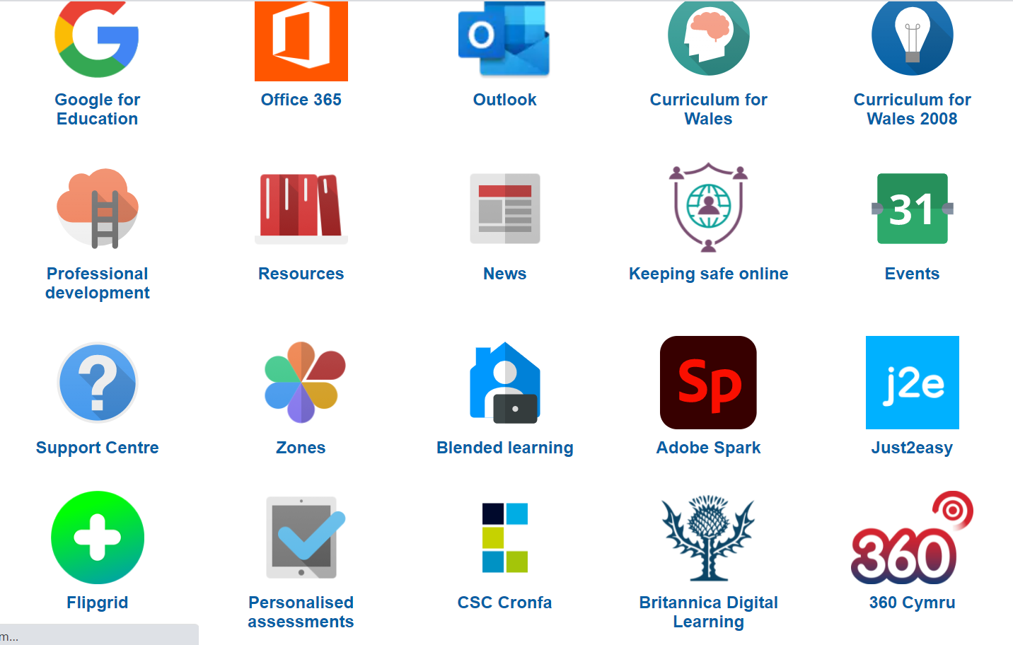
Homework
Please remember that there are many free resources available on Hwb to help them with their learning.

Slide 17


E-Safety
Hwb has a variety of information for parents and children on keeping safe online.
Common Sense Media is an excellent website for searching different games, apps and films. The reviews on there will help you make informed decisions on whether the media is appropriate for your child.

Slide 18
Other Information …
Parents’ Evenings this term will be during the week commencing 13th October​. (Online and face to face)
Please check the newsletter every week for dates and events as well as information about what has been happening in school.
Any questions?

