Slide 1

Year 3
Blwyddyn 3
Meet the Teachers

Slide 2

Croeso
Thank you for coming to this parent’s information meeting.
We hope that your child has a positive and rewarding experience during their time in Year 3.
Please feel free to ask
any questions at the end
of this presentation.

Slide 3

Our Team
3S - Miss Smith
3B - Mrs Barnett
PPA - Wednesday Morning
Mrs Warne-Jones &
Mr Whitting

Slide 4
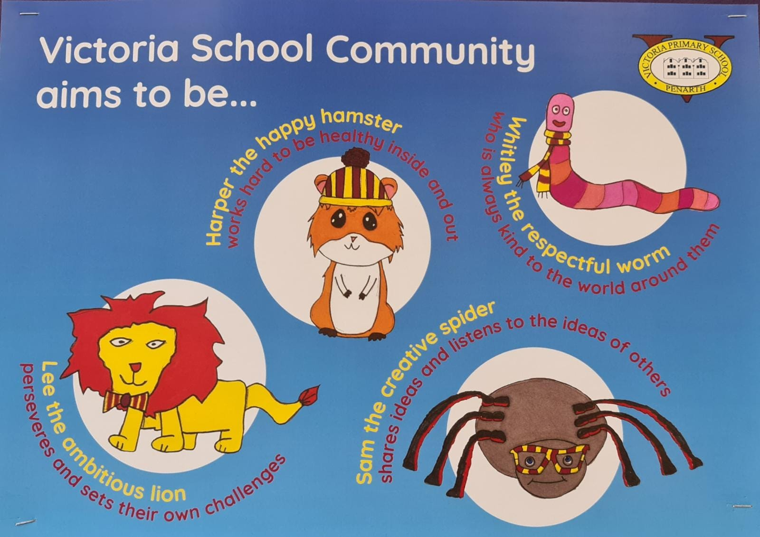

Slide 5

Curriculum for Wales

Slide 6
Children’s Independent Ideas
Science and Technology Investigate materials to make a roundhouse. Expressive Arts Make an item for a warrior / act out a battle scene Mathematics and Numeracy How old would Boudicca now be and how old was she when she reigned? LLC Which languages did the Celts speak? Health and Well-Being Were animals kept as pets? Everyday living – did they have toilets? Humanities Who were the Celts?
These are linked to the 6 Areas of Learning.

Slide 7
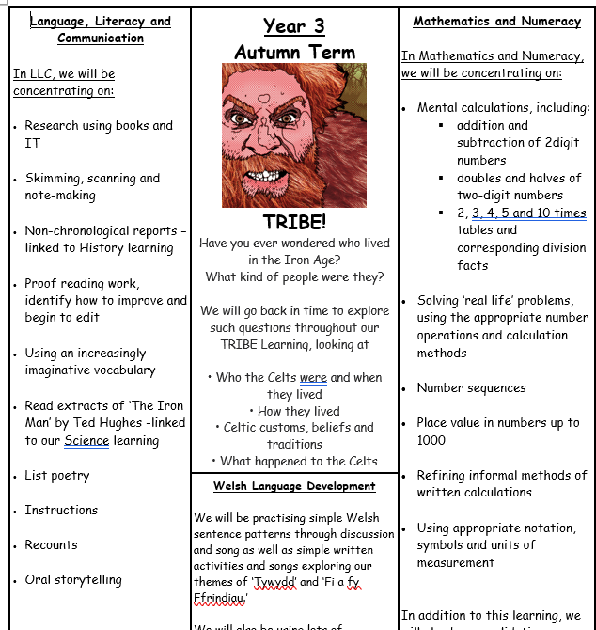
Curriculum Overview
Termly
Overview of what we hope to cover
Trips and Visitors
Links to topic websites

Slide 8

Autumn Term
This term our year group will be focusing on Humanities, and we will be delivering the following topic:
Tribe – Iron Age Celts
In this project, children will explore:
• Who the Celts were and when they lived.
• How they lived.
• Celtic customs, beliefs and traditions.
• What happened to the Celts?

Slide 9


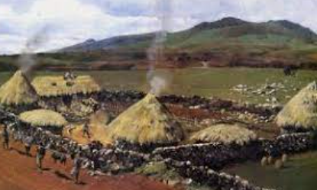
Educational Visits and
Parent Support
We aim for children to undertake educational visits.
If you have an interest/occupation linked to a topic and would like to talk to the class about it, please see your child’s teacher.
.

Slide 10

Growth Mindset
As a whole school initiative, this year we will be working on Growth Mindset with the pupils.
We will deliver a series of lessons focusing on
facing challenges, resilience, making mistakes, effort and being positive.

Slide 11
Uniform
Grey trousers/skirt
Yellow T-shirt
Burgundy sweatshirt
Black, sensible shoes
Long hair tied back
No jewellery
(only watches & stud earrings; no smart watches)
P.E Kit
To be worn to school on their designated P.E days.
Tuesday and Thursday
White t-shirt
Black bottoms (shorts, joggers, leggings, skorts)
To be worn with a school jumper or cardigan.

Slide 12


Snack
Our breaktime is later, in the morning which makes for a long morning, and the children do get hungry!
Please ensure that these are fruit or veg based snacks.
All children to bring in a water bottle (containing water only)

Slide 13

Home Reading
The children will be put into groups for their Guided Group Reading over the next couple of weeks.
They will then be given a specific day of the week to return their reading book and reading record. A new book will be sent out the same day.
Please adhere to your child's designated day for exchanging their reading book.​ (It will be written inside their reading record).

Slide 14

Rules and Rewards
Be Ready,
Be Safe,
Be Respectful
Star points
Stickers
Star of the Week
Recognition Board

Slide 15
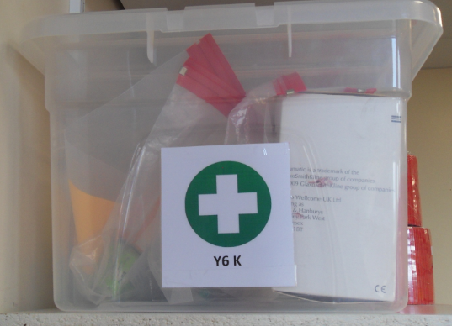
Medical information
All medicines should be in date. We are only allowed to give prescribed medicines from the doctor with written permission.

Slide 16
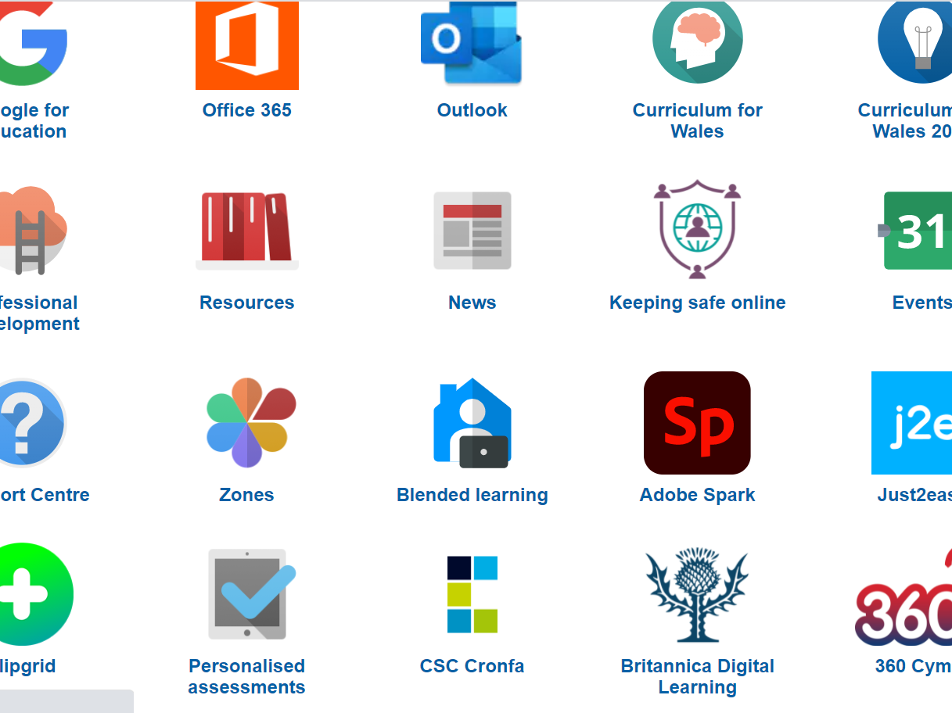
Home-Learning
Home-learning will be posted on a new Google Classroom specifically for home-learning. The assignment will include instructions and links appropriate to the home-learning.
Please remember that there are many free resources available on Hwb to help them with their learning. All children have access to:

Slide 17
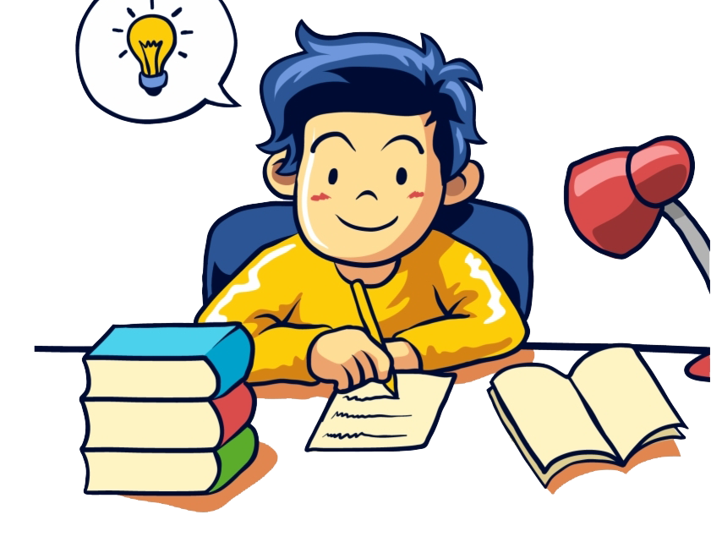
What we would expect the children to do regularly at home:
Multiplication tables – We are looking for accuracy and speed. We expect children to learn and use the 2x, 3x, 4x, 5x and 10x tables
Mental Maths – encourage these skills during everyday life – shopping, telling the time, reading TV timetables, cooking etc.
Reading – This can be independent, witnessed and signed by an adult. However, it is always good for an adult to try to question the child about the text whenever possible.

Slide 18


E-Safety
Hwb have a variety of information for parents and children on keeping safe online.
Commonsense media is an excellent website for searching different games, apps and films. The reviews on there will help you make informed decisions on whether the media is appropriate for your child.

Slide 19
Parents’ Evenings: Wc 13th October
Opportunity for either face-to-face or online meetings.
Please see the newsletter for specific dates.
Look out for an email to book an appointment.
Please check the newsletter and Google
Classroom every week for dates and events as well as information about what has been happening in our school.

Slide 20
Any questions?

