Slide 1
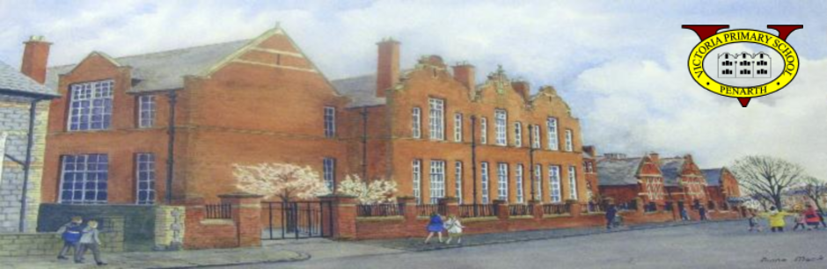
Croeso i
Ysgol Gynradd Victoria
Welcome to
Victoria Primary School

Slide 2

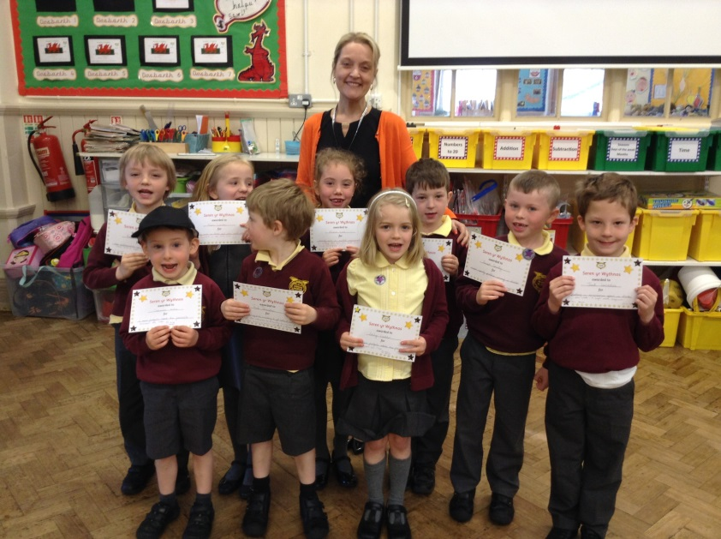
School Motto
Together we aim for the stars

Slide 3
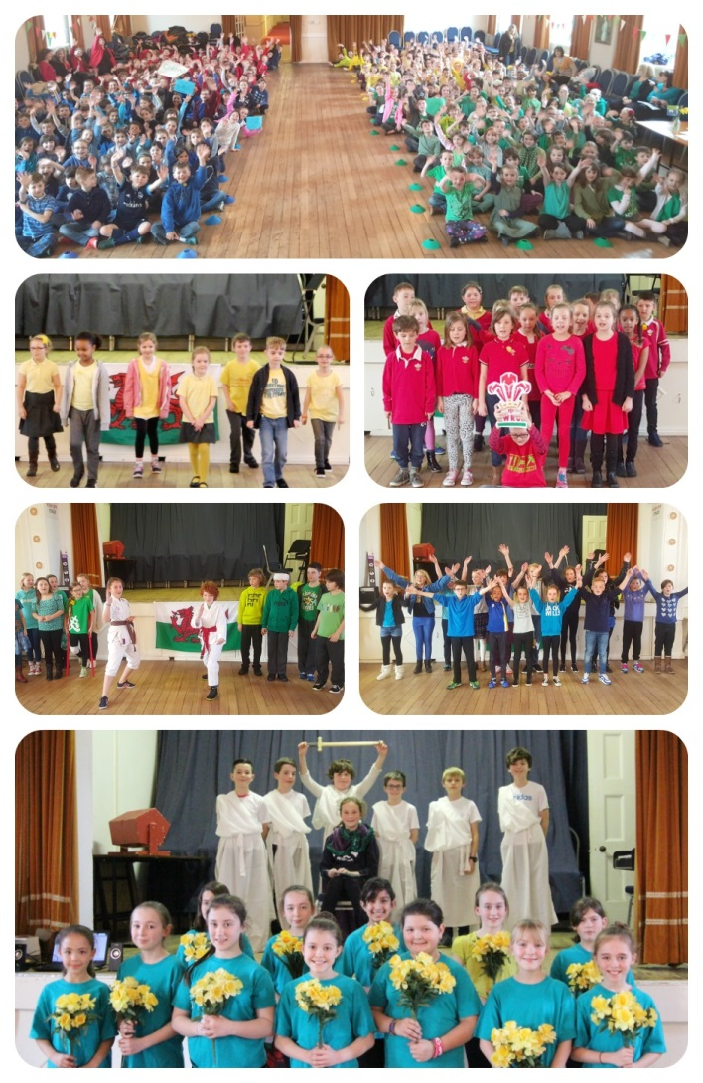
Vision Statement
Our vision is to provide a nurturing and inclusive environment that facilitates a love of learning. By working together, we strive to foster happy, respectful relationships among all members of our community, equipping our children with the resilience needed to embrace challenge and safely navigate their futures.

Slide 4
VPS Rules
Be Ready
Be Safe
Be Respectful

Slide 5
PTA
The school relies heavily on the PTA for support
The PTA helps raise funds for new books, equipment, and music lessons, providing valuable resources that benefit all of the children
If you can help in any way, whether by volunteering your time, it would be greatly appreciated

Slide 6
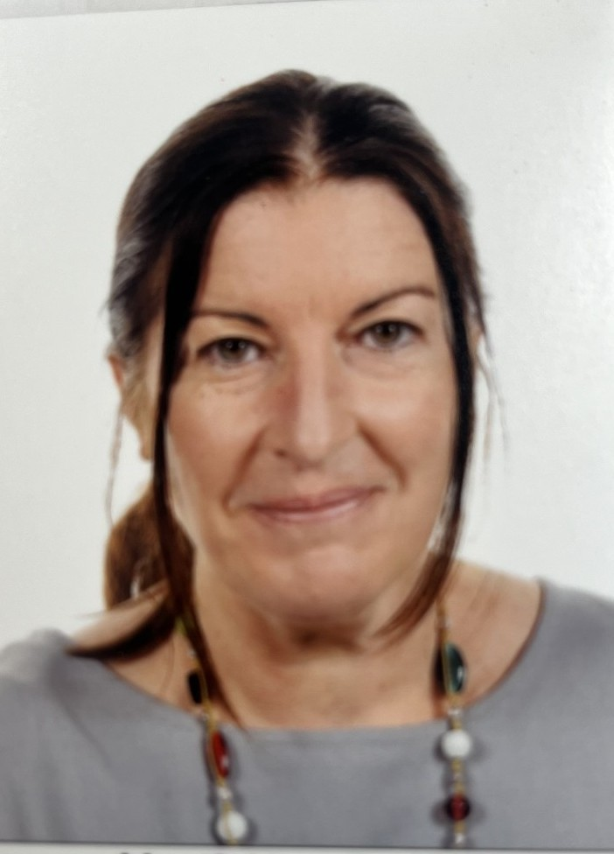
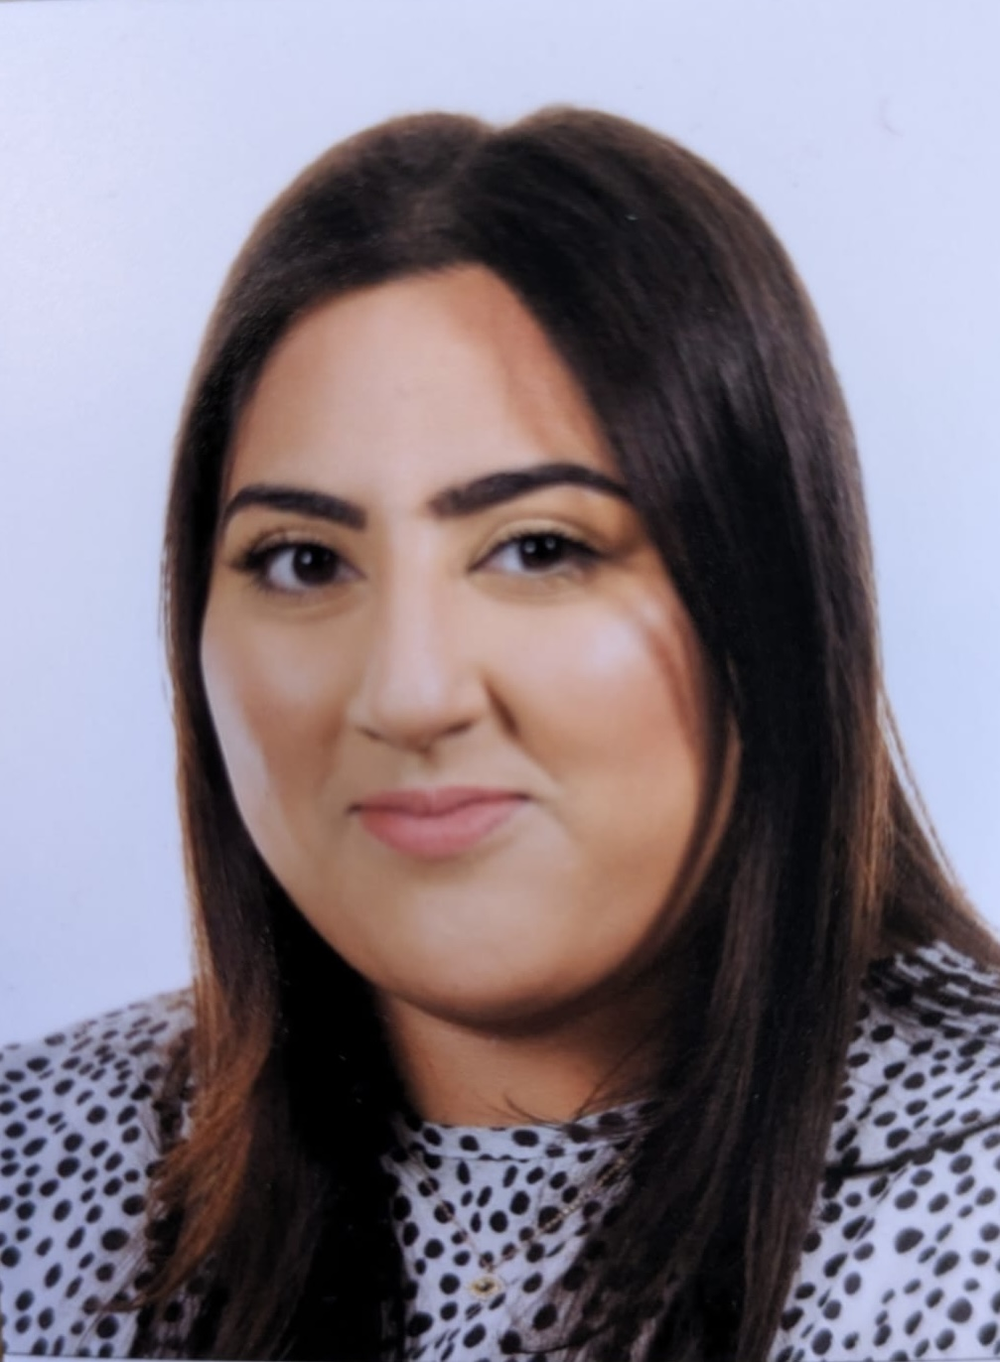
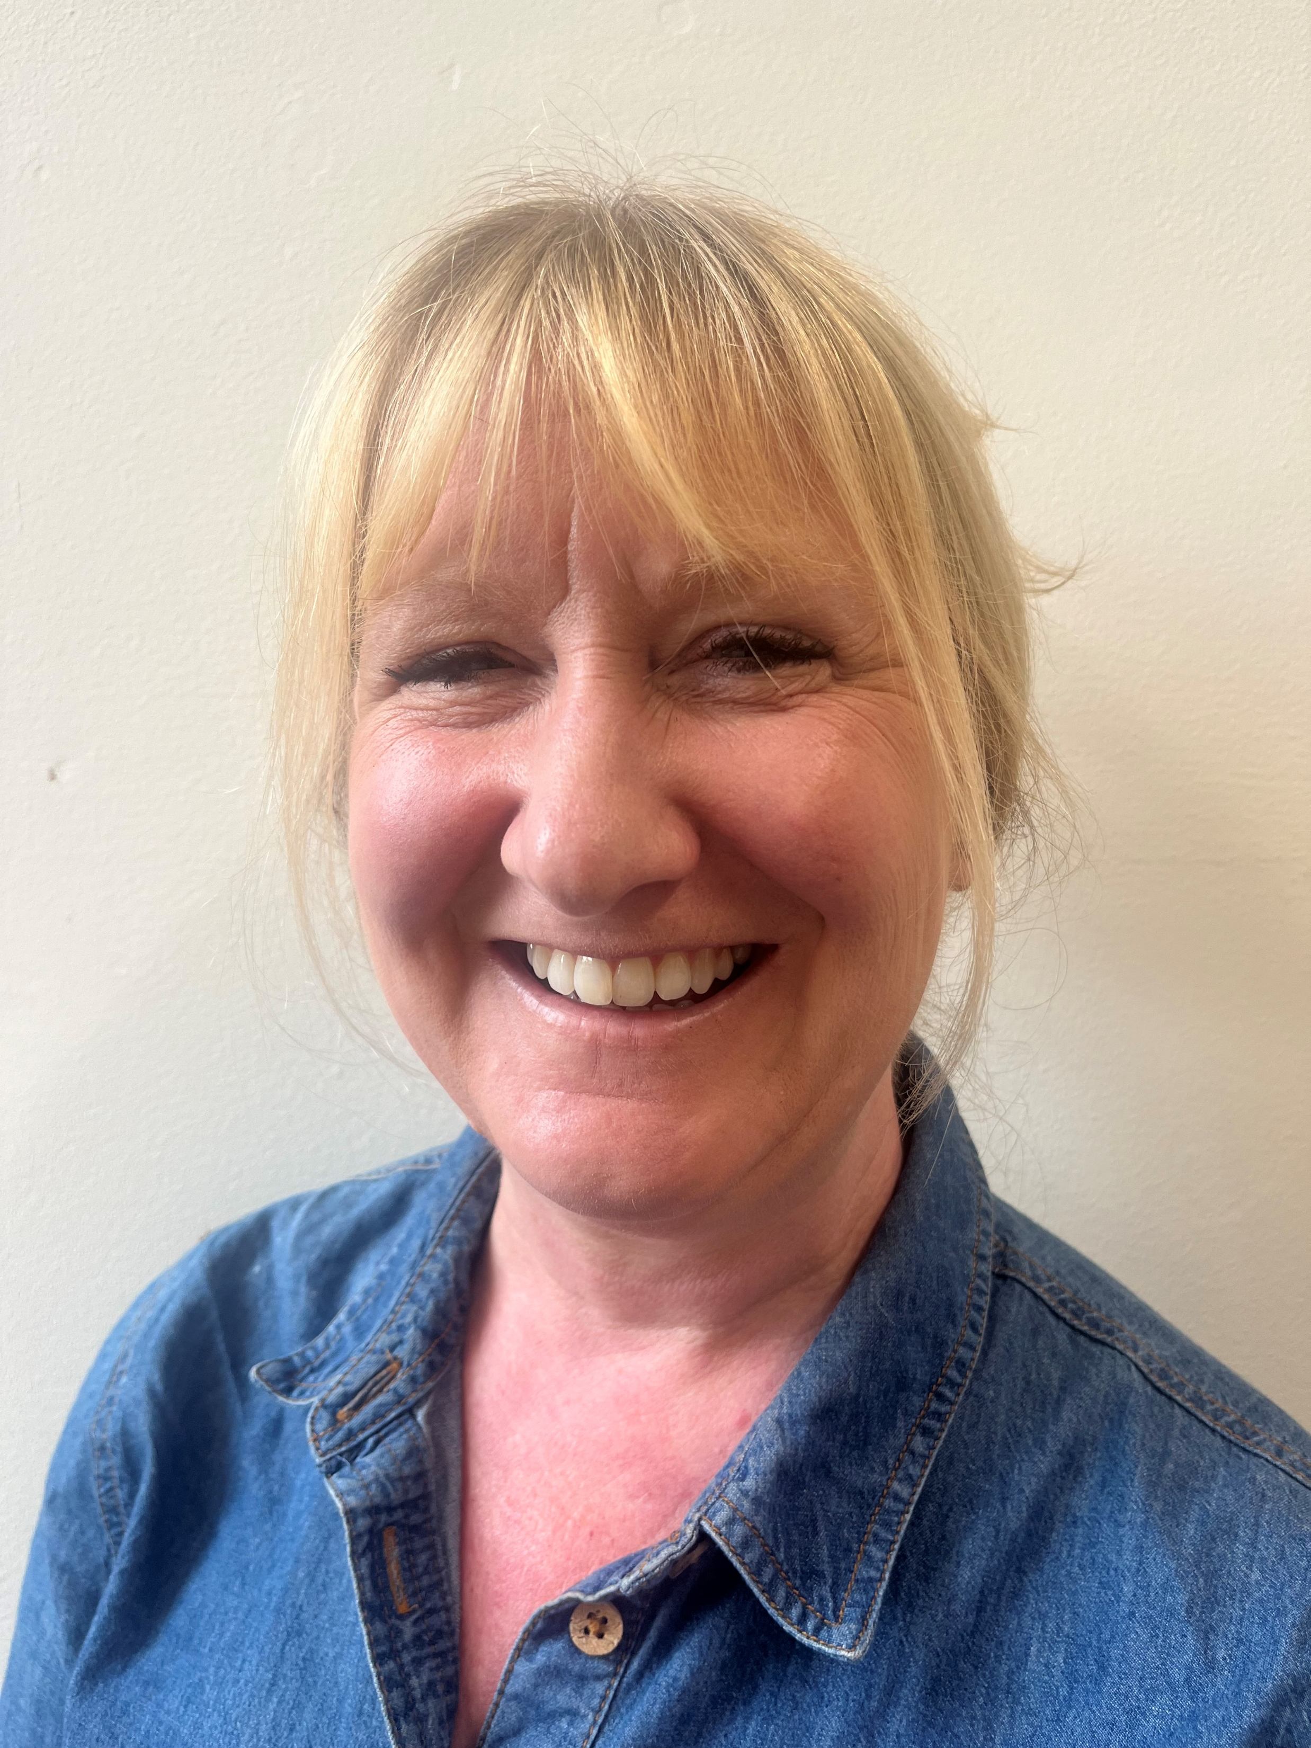
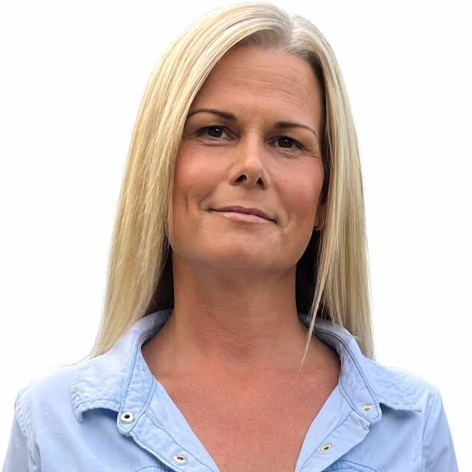
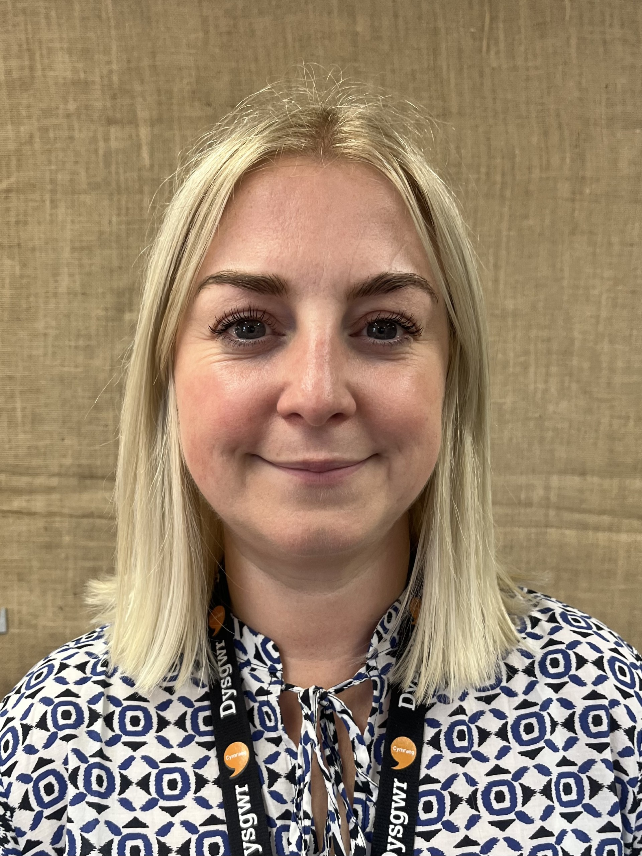
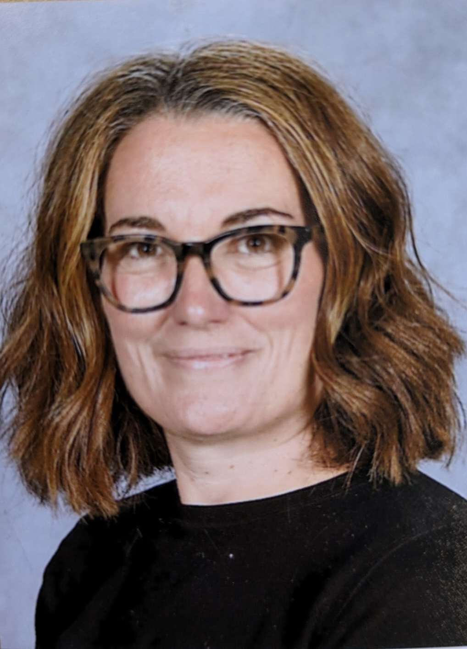
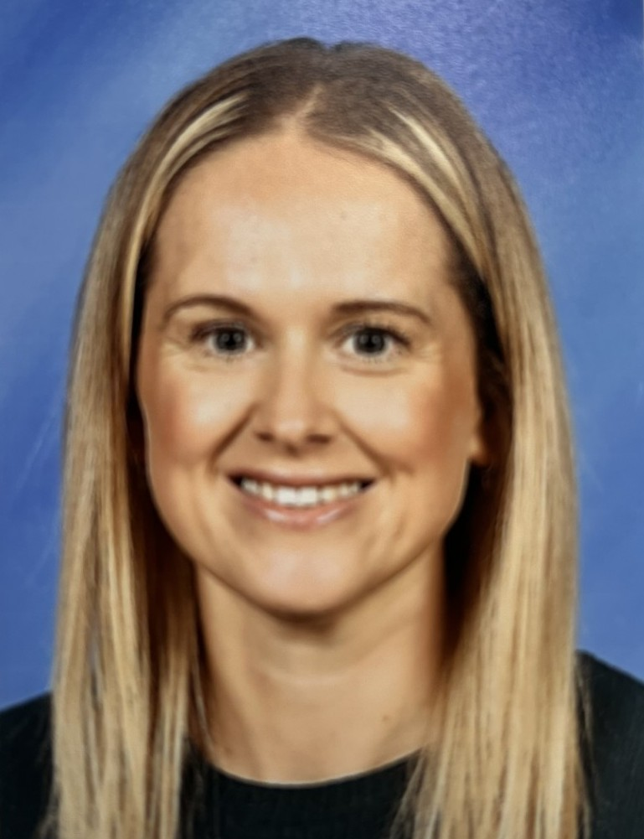
Foundation Phase Reception Team
Mrs Kerr Smith
RKSD
Mrs Bhatia-Roy
LSA
Mrs Dobson
RKSD
Mrs David
RDH
Mrs Curtis
LSA
Mrs Halliwell
RDH
Mrs Evans
LSA

Slide 7
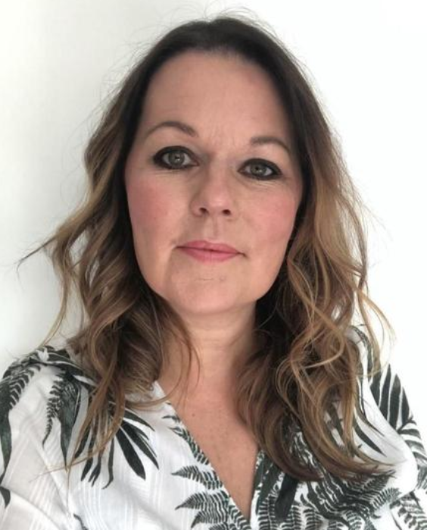
Additional Learning Needs
Mrs J Hall
Additional Learning Needs Coordinator
Contact : HallJ178@hwbcymru.net or call the main office to leave a message

Slide 8
Welcome Pack
New teacher Letter
Welcome Booklet
Information on contacting the school
Parent Pay Login (If on our system)
Free Breakfast Club
PTA letter
Letter and number formation sheets
Victoria Out of Hours School Club

Slide 9
Timings
Doors open at 8:45 for prompt 8:55 start
Morning session: 8:55 - 11:30
Lunch: 11:30 - 12:30
Afternoon Session: 12:30 - 3:25

Slide 10
Curriculum for Wales
There are 6 Areas of Learning Experiences
Health & Wellbeing
Languages, Literacy and Communication
Mathematics & Numeracy
Science &Technology
Expressive Arts
Humanities

Slide 11
PE
We have two PE sessions a week
One indoor and one outdoor
You will be informed of these days as soon as we have the whole school timetable
Pupils can wear white t shirts, black shorts/jogging bottoms/leggings

Slide 12
Reading books
Your child will be given reading books when they can segment and blend words and read key high frequency words -Please practice these frequently!!!

Slide 13
Passing on information
Open door policy - Adult on the door each morning
School website
School email
School message - ARBOR
Weekly newsletter
Monthly Information letters with key contact numbers for additional services
Reporting:
Termly parent/teacher meetings
Annual reports

Slide 14

Helping Hand
Weekly (following our baseline assessments)
Gives information of what we will be covering in following week and activities to help support your child
Seesaw App

Slide 15
School Dinners
School dinners are ordered on the door with class LSAs
Children can order a free meal of their choice
The options range from a hot meal, baguettes or baked potato
The menu is available for parents to see on our school website, so choices can be made in advance with your child

Slide 16
What does your child need?
School uniform
Warm, waterproof coat in winter
Shower-proof coat, sunhat in summer
Water bottle
PE kit – to be worn to school
Book Bag – sent home on a Friday, returned to school on a Wednesday.
Please LABEL all clothing, bottles, bags!!

Slide 17
Birthdays
We are happy to give out invites providing there is one for everyone in the class. If you are having a small party, we ask that you give the invites out yourselves
As part of our Healthy Schools, we are sorry that we cannot give out Birthday cake or sweets

Slide 18
What happens next…
Help to prepare your children over the holidays:
Encourage them to put coats on, shoes etc
Play games, taking turns, talk to them about things around them e.g. numbers, seasons
Show them how to tidy up after play activities

Slide 19
First day
Important day for you and your child
Leave cheerfully and promptly
Common for children to cry, most children settle down quickly, we will ring if they don’t!

