Slide 1
Interventions at Victoria
Who?
What?
Why?

Slide 2
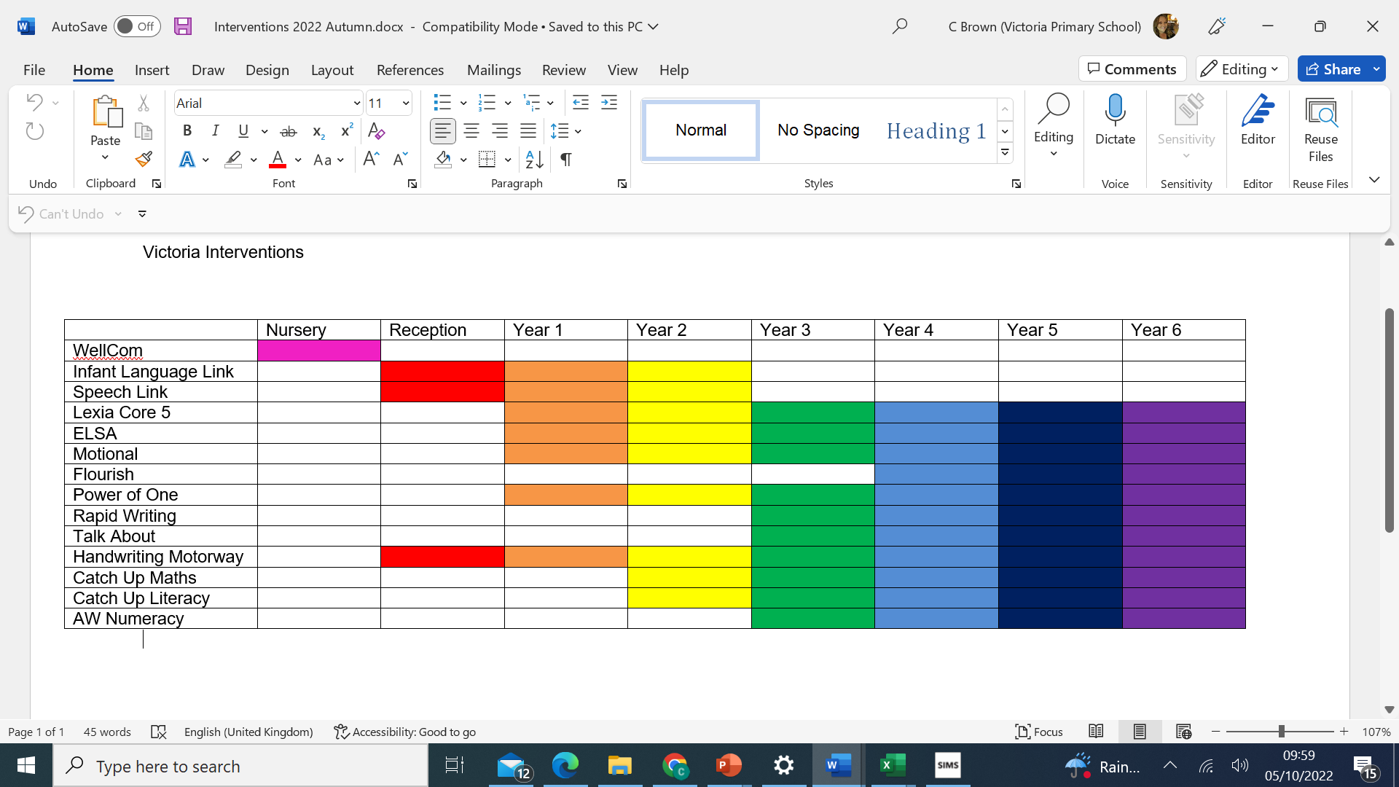
Interventions at Victoria

Slide 3
Nursery - WellCom
Delayed language skills lead to under-performance later in life, yet many primary school children have unidentified speech and language difficulties. WellComm helps to turn this around.
The WellComm toolkits were developed by Speech and Language Therapists at Sandwell and West Birmingham Hospitals NHS Trust with the aim of providing easy to use support for everyone involved with children.
Requiring no specialist expertise, they quickly identify areas of concern in language, communication, and interaction development in order to ensure early targeted intervention.
Once a profile has been drawn up for each child, The Big Book of Ideas provides focused teaching and intervention activities to meet individual needs.
Reports for each child are easy to follow. Green = no intervention needed, Amber = provide extra support and Red = consider referral to an SLT. Advice and follow-up activities are suggested, and re-screening shows you whether the child is improving.

Slide 4
Reception, Year 1 & Year 2 – Language Link
Infant Language Link is used to identify and support children with mild to moderate SLCN and those new to English. The assessment will also identify any children who may have more severe language needs, such as Developmental Language Disorder (DLD), so that these children can be considered for further investigations and diagnostic assessment with the Vale Speech and Language Therapy team.
The online, adult led standardised assessment looks at key areas of understanding of language for the classroom.
Infant Language Link provides planned and resourced interventions for a graduated approach. Recommended high quality teaching strategies and classroom resources allow the LSA to support SLCN universally.

Slide 5
Year 1 onwards – lexia
Lexia® Core5® Reading is a fun, computer-based program that has helped millions of Pre-K-5 students improve their literacy skills.
The activities in Core5 support and build on classroom curriculum, and focus on developing reading skills in six areas: phonological awareness, phonics, structural analysis, fluency, vocabulary, and comprehension.
Comprehension - understanding spoken and written language
Pupils take a brief placement activity and begin the online program at a starting point that is right for them.​
Teachers have access to student progress and performance reports, so that they can provide assistance when needed. ​
In addition to the online program, students use paper-and-pencil and hands-on activities for practicing and extending skills.​
Pupils learn achievement certificates when they complete levels. These certificates are a great opportunity to celebrate success and talk about newly-gained skills!

Slide 6
Year 1 onwards – lexia
What skills does Core5 teach?
Core5 provides a structured and systemic approach to six critical areas of reading:
Phonological Awareness - recognizing sounds in words
Phonics - understanding the connection between sounds and letters
Structural Analysis - recognizing meaningful parts in words
Fluency - reading smoothly and with expression
Vocabulary - understanding word meanings and relationships
Comprehension - understanding spoken and written language

Slide 7
Reception, Year 1 & Year 2 – Speech link
Speech Link is used to identify and support children with developmental speech sound difficulties.
The online, screening assessment is fun, quick and easy to administer. It identifies whether a child’s speech is as it should be for their age. If a delay is present the package will recommend a programme of work. It will clearly indicate when a Speech and Language Therapist’s opinion is required, helping you make the most of your external agency support.
The ability to hear the difference between different speech sounds is essential for both speech and literacy development. The interactive online listening games can be used across the whole class to develop good listening, auditory analysis and sound discrimination skills.

Slide 8
ELSA
ELSA stands for emotional literacy support assistant - this wiki tells you more about what ELSAs do in schools and how they support children.
What is ELSA?
Ins schools, ELSA stands for Emotional Literacy Support Assistant. ELSA support in schools is a project designed to help schools support the emotional needs of their pupils.
ELSA acknowledges that children and young people learn best when they feel happier and their emotional needs are being addressed.
The initiative was developed and supported by educational psychologists who used knowledge of how children develop socially and emotionally and apply this knowledge to the needs of pupils.
The role title of ELSA may only be taken by someone who:
Has attended a full ELSA training course.
Regularly attends supervision groups led by educational psychologists.
Currently, are developing bespoke programmes to support the emotional needs of children in their school.

Slide 9
What can ELSAs help with?
There are a lot of emotional skills that ELSA can help with, including:
Social Skills
Bereavement
Social Situations
Therapeutic Stories
Anger Management
Self-esteem
Real-life problem-solving skills
Friendship

Slide 10
How long should an ELSA Programme last?
There are very few cases where ELSA should become a permanent feature of a child’s support system, as the programme works best when there are aims for children to work towards and achieve. When planning a child’s individual ELSA programme, it is a good idea to plan a term’s worth of work.
Further intervention towards new aims can be put in place at a later date if it becomes required.
Sessions will typically happen once a week across the length of a term and last between half an hour and an hour. During a session, an ELSA should:
Check how the child is and how they have been feeling for the past week.
Review the content that was covered in the last session and see if any of the information needs to be revisited.
To introduce new content through engaging games and activities.
End the session in a way that helps the child to adjust to going back to class.

Slide 11
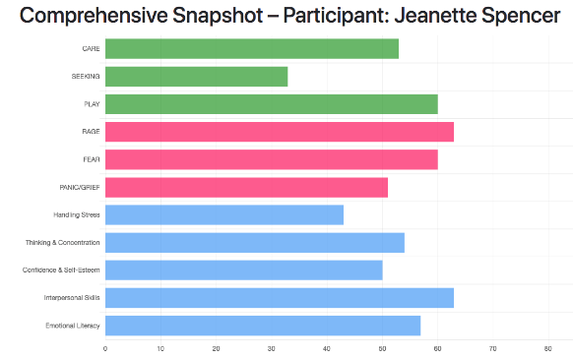
MOTIONAL
Motional’s Snapshot tool uses a series of questions to help adults better understand how well a child or young person is functioning in terms of their mental health and wellbeing. For speed and simplicity, we have created a quick Universal Snapshot for all children, undertaken either individually or as a group.
A Comprehensive Snapshot is also then available for individual children or young people who have been identified as needing a little more support and / or 1:1 intervention. The snapshots are based on the same fundamental underpinnings; The Universal Snapshot is simply a shorter version of the Comprehensive.

Slide 12
Both levels of Snapshot allow you to create a Program of strategies and link with a wealth of practical activities known to support emotional development and to heal troubled children’s minds, brains, and ability to learn. The research base shows that these interventions can support children and teenagers who have mental health difficulties to go on to lead fulfilling lives.
Our Programs tie in with the well-developed models of practice such as PACE, but are not specific to any specific provider. Each Program includes guidance (with extra detail for Practitioners) in protecting and relating to children. This guidance is tailored to the child you work with based on the scores in the Snapshot
Each activity has a thorough description and step-by-step guide, together with key relationship-building approaches to help support and focus the impact this has on the child / young person or group.
Programs can be created for Individuals and Groups.

Slide 13
FLOURISH
The Flourish Project has been created to help young people to develop a growth mindset, creating helpful thinking patterns and enabling the young person to start to understand their potential, realizing future aspirations and setting goals for the future.
1 in 10 children and young people aged 5-16 years old have clinically diagnosable mental problems. The statistics paint a picture of a generation increasingly struggling with mental and emotional health resulting in anxiety, depression, self-harm and suicide.

Slide 14
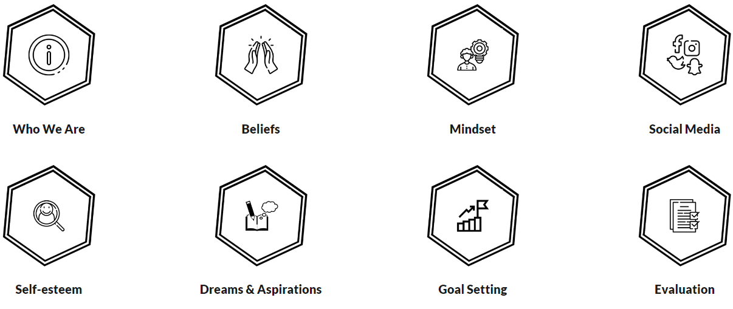
Flourish sessions include topics on

Slide 15
POWER OF ONE
Who is it suitable for?
Plus 1 is ideal for anyone who benefits from repeated maths practice. It's designed to appeal to all age ranges and it suitable from 6 years old, right up to adult basic skills. The clear language and repetition benefits students with dyslexia and those with English as an Additional language. Students with dyscalculia benefit from the highly structured approach with clear explanations.
Age range – 5 year olds to basic adult numeracy
Special needs – Dyslexia, Dyscalculia
What topics does the book cover?
The book covers basic number work, such as counting forwards and backwards with numbers up to 10, adding and subtracting numbers up to 10, and introducing doubling and halving. It is for anyone who benefits from repeated practice and explanation as the book, Plus 1, stems from the need of some people to have more reinforcement and practice than is often available.
Counting backwards and forwards
Adding and subtracting up to 10
Introduction to doubling and halving

Slide 16
Rapid Writing
Writing catch-up for struggling learners that's proven to work
Rapid Writing is a different approach to writing catch-up. Ideal for use with small groups or for one-to-one support, it's perfect for helping close the attainment gap in writing. Created by expert authors, you can be reassured that the progression is spot on and will help children succeed across the whole curriculum.
Rapid Writing contains pupil writing logs for small group and independent writing sessions, and teaching guides to help make every writing intervention effective. It is designed for use by SEN and struggling writers at KS2.

Slide 17
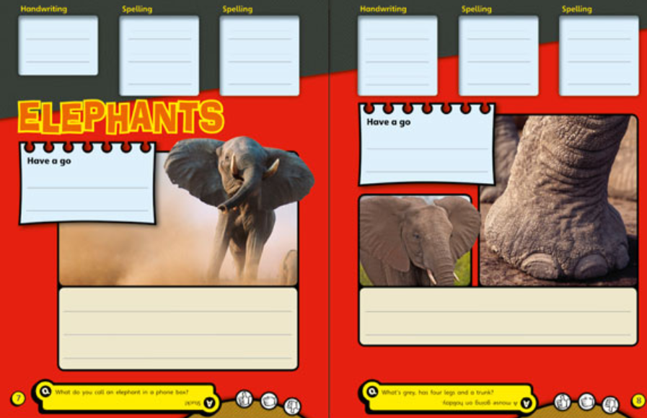
With fun contexts and fantastic designs, these finely levelled writing logs are designed to help your children tackle the elements of writing they find most difficult to master. They support and scaffold their writing, helping them to enjoy and take pride in their finished work.
The comic-book style appeals, especially to boys, and the age-appropriate content will help keep them on task as they work through short, achievable tasks to help build their confidence.
From spelling and punctuation tasks, to sentence structure and writing for different genres and text types, Rapid’s writing logs will help your children tackle and improve all areas of their writing.
Using familiar characters from the Rapid Reading books, these Rapid Writing logs are a great way to support the link between reading and writing.

Slide 18
TALKABOUT
Talkabout is a structured programme for teaching and measuring social skills. It is a whole scheme of work which helps you assess, teach and measure your work easily. It uses a hierarchical method of teaching social skills which means that having assessed the child using the Talkabout assessment, teachers will choose the appropriate level or book to start work at. This means that you may start by developing a child’s self-awareness and self-esteem before progressing onto body language. You will then move onto conversation skills and then onto friendship skills and assertiveness.

Slide 19
Talkabout is…
A hierarchical approach to teaching social skills: foundation skills are taught prior to more complex skills.
Includes an assessment and outcome measures: the Talkabout assessment includes a method of quantifying results and if you attend Alex’s training, she gives you additional systems to measure effectiveness through using targets and spreadsheets.
Includes activities and plans of intervention: Talkabout is a scheme of work that is designed to be followed week by week, with plans for your intervention divided into 3 academic terms for anyone working in schools.
Suitable for all ages: the different books are designed with a certain population in mind, so that you will use the resource best suited to your client group, from young children (4+) to adults.
Suitable to put onto a school curriculum: the Talkabout resources have been written with schools in mind, so that teachers can easily put social skills into their lessons or onto their curriculum.
Proven effectiveness: Talkabout has been proved to be an effective tool for developing self-esteem, social skills and friendship skills and Alex is happy to share evidence from schools who have measured their progress.
A social skills textbook: Alex has recently written a textbook on social skills which combines sound theory with experience and evidence to make it an essential book for anyone wanting to further their knowledge of social skills.

Slide 20
Handwriting Motorway is ….
a collaboration between Children’s Occupational Therapy Service (OT), UHB and Schools and Lifelong Learning (LLT) from Cardiff Local Authority
rolled out to schools in the Vale and Cariff.
encourages a whole school approach to motor skill development
enables schools to support children with developmental delays and motor difficulties to make progress without the need to refer into the specialist services such as OT

